Slide 1
CHAPTER 16
Disk Storage, Basic File Structures, Hashing, and Modern Storage Architectures

Slide 2
16.1 Introduction
Databases typically stored on magnetic disks
  Accessed using physical database file structures
Storage hierarchy
  Primary storage
    CPU main memory, cache memory
  Secondary storage
    Magnetic disks, flash memory, solid-state drives
  Tertiary storage
    Removable media

Slide 3
Memory Hierarchies and Storage Devices
Cache memory
  Static RAM
  DRAM
Mass storage
  Magnetic disks
    CD-ROM, DVD, tape drives
Flash memory
  Nonvolatile

Slide 4
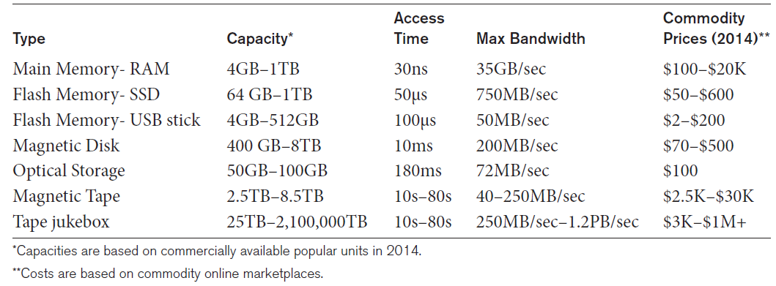
Storage Types and Characteristics
Table 16.1 Types of Storage with Capacity, Access Time, Max Bandwidth (Transfer Speed), and Commodity Cost

Slide 5
Storage Organization of Databases
Persistent data
  Most databases
Transient data
  Exists only during program execution
File organization
  Determines how records are physically placed on the disk
  Determines how records are accessed

Slide 6
16.2 Secondary Storage Devices
Hard disk drive
Bits (ones and zeros)
  Grouped into bytes or characters
Disk capacity measures storage size
Disks may be single or double-sided
Concentric circles called tracks
  Tracks divided into blocks or sectors
Disk packs
  Cylinder

Slide 7
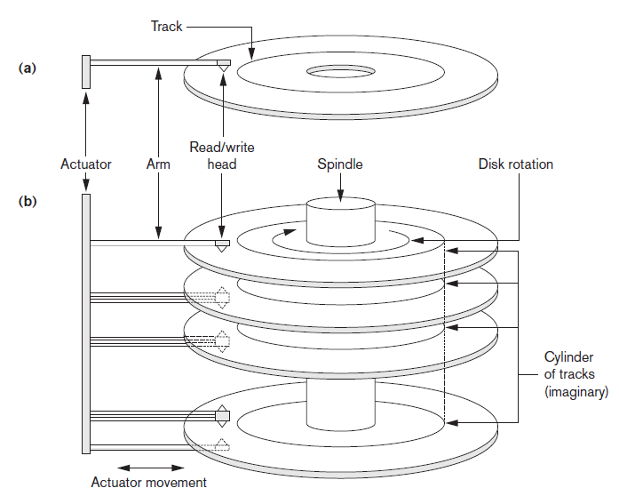
Single-Sided Disk and Disk Pack
Figure 16.1 (a) A single-sided disk with read/write hardware (b) A disk pack with read/write hardware

Slide 8
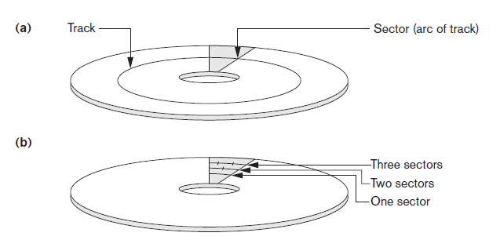
Sectors on a Disk
Figure 16.2 Different sector organizations on disk (a) Sectors subtending a fixed angle (b) Sectors maintaining a uniform recording density

Slide 9
Secondary Storage Devices (cont’d.)
Formatting
  Divides tracks into equal-sized disk blocks
  Blocks separated by interblock gaps
Data transfer in units of disk blocks
  Hardware address supplied to disk I/O hardware
Buffer
  Used in read and write operations
Read/write head
  Hardware mechanism for read and write operations

Slide 10
Secondary Storage Devices (cont’d.)
Disk controller
  Interfaces disk drive to computer system
  Standard interfaces
    SCSI
    SATA
    SAS

Slide 11
Secondary Storage Devices (cont’d.)
Techniques for efficient data access
  Data buffering
  Proper organization of data on disk
  Reading data ahead of request
  Proper scheduling of I/O requests
  Use of log disks to temporarily hold writes
  Use of SSDs or flash memory for recovery purposes

Slide 12
Solid State Device Storage
Sometimes called flash storage
Main component: controller
Set of interconnected flash memory cards
No moving parts
Data less likely to be fragmented
More costly than HDDs
DRAM-based SSDs available
  Faster access times compared with flash

Slide 13
Magnetic Tape Storage Devices
Sequential access
  Must scan preceding blocks
Tape is mounted and scanned until required block is under read/write head
Important functions
  Backup
  Archive

Slide 14
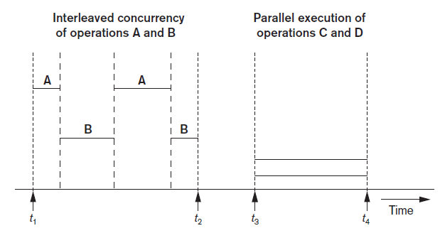
16.3 Buffering of Blocks
Buffering most useful when processes can run concurrently in parallel
Figure 16.3 Interleaved concurrency versus parallel execution

Slide 15
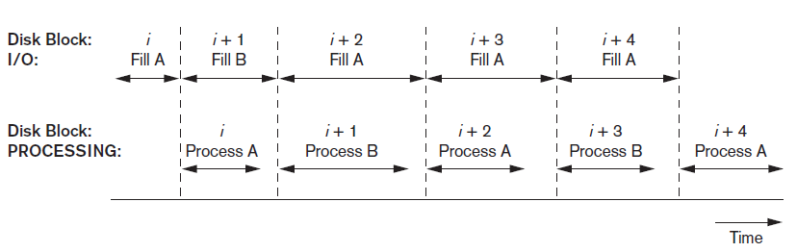
Buffering of Blocks (cont’d.)
Double buffering can be used to read continuous stream of blocks
Figure 16.4 Use of two buffers, A and B, for reading from disk

Slide 16
Buffer Management and Replacement Strategies
Buffer management information
  Pin count
  Dirty bit
Buffer replacement strategies
  Least recently used (LRU)
  Clock policy
  First-in-first-out (FIFO)

Slide 17
16.4 Placing File Records on Disk
Record: collection of related data values or items
  Values correspond to record field
Data types
  Numeric
  String
  Boolean
  Date/time
Binary large objects (BLOBs)
  Unstructured objects

Slide 18
Placing File Records on Disk (cont’d.)
Reasons for variable-length records
  One or more fields have variable length
  One or more fields are repeating
  One or more fields are optional
  File contains records of different types

Slide 19
Record Blocking and Spanned Versus Unspanned Records
File records allocated to disk blocks
Spanned records
  Larger than a single block
  Pointer at end of first block points to block containing remainder of record
Unspanned
  Records not allowed to cross block boundaries

Slide 20
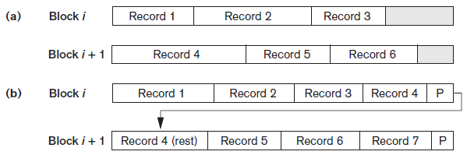
Record Blocking and Spanned Versus Unspanned Records (cont’d.)
Blocking factor
  Average number of records per block for the file
Figure 16.6 Types of record organization (a) Unspanned (b) Spanned

Slide 21
Record Blocking and Spanned Versus Unspanned Records (cont’d.)
Allocating file blocks on disk
  Contiguous allocation
  Linked allocation
  Indexed allocation
File header (file descriptor)
  Contains file information needed by system programs
    Disk addresses
    Format descriptions

Slide 22
16.5 Operations on Files
Retrieval operations
  No change to file data
Update operations
  File change by insertion, deletion, or modification
Records selected based on selection condition

Slide 23
Operations on Files (cont’d.)
Examples of operations for accessing file records
  Open
  Find
  Read
  FindNext
  Delete
  Insert
  Close
  Scan

Slide 24
16.6 Files of Unordered Records (Heap Files)
Heap (or pile) file
  Records placed in file in order of insertion
Inserting a new record is very efficient
Searching for a record requires linear search
Deletion techniques
  Rewrite the block
  Use deletion marker

Slide 25
16.7 Files of Ordered Records (Sorted Files)
Ordered (sequential) file
  Records sorted by ordering field
    Called ordering key if ordering field is a key field
Advantages
  Reading records in order of ordering key value is extremely efficient
  Finding next record
  Binary search technique

Slide 26
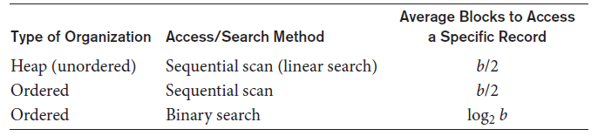
Access Times for Various File Organizations
Table 16.3 Average access times for a file of b blocks under basic file organizations

Slide 27
16.8 Hashing Techniques
Hash function (randomizing function)
  Applied to hash field value of a record
  Yields address of the disk block of stored record
Organization called hash file
  Search condition is equality condition on the hash field
  Hash field typically key field
Hashing also internal search structure
  Used when group of records accessed exclusively by one field value

Slide 28
Hashing Techniques (cont’d.)
Internal hashing
  Hash table
Collision
  Hash field value for inserted record hashes to address already containing a different record
Collision resolution
  Open addressing
  Chaining
  Multiple hashing

Slide 29
Hashing Techniques (cont’d.)
External hashing for disk files
  Target address space made of buckets
  Bucket: one disk block or contiguous blocks
Hashing function maps a key into relative bucket
  Table in file header converts bucket number to disk block address
Collision problem less severe with buckets
Static hashing
  Fixed number of buckets allocated

Slide 30
Hashing Techniques (cont’d.)
Hashing techniques that allow dynamic file expansion
  Extendible hashing
    File performance does not degrade as file grows
  Dynamic hashing
    Maintains tree-structured directory
  Linear hashing
    Allows hash file to expand and shrink buckets without needing a directory

Slide 31
16.9 Other Primary File Organizations
Files of mixed records
  Relationships implemented by logical field references
  Physical clustering
B-tree data structure
Column-based data storage

Slide 32
16.10 Parallelizing Disk Access Using RAID Technology
Redundant arrays of independent disks (RAID)
  Goal: improve disk speed and access time
Set of RAID architectures (0 through 6)
Data striping
  Bit-level striping
  Block-level striping
Improving Performance with RAID
  Data striping achieves higher transfer rates

Slide 33
Parallelizing Disk Access Using RAID Technology (cont’d.)
Improving reliability with RAID
  Redundancy techniques: mirroring and shadowing
RAID organizations and levels
  Level 0
    Data striping, no redundant data
    Spits data evenly across two or more disks
  Level 1
    Uses mirrored disks

Slide 34
Parallelizing Disk Access Using RAID Technology (cont’d.)
RAID organizations and levels (cont’d.)
  Level 2
    Hamming codes for memory-style redundancy
    Error detection and correction
  Level 3
    Single parity disk relying on disk controller
  Levels 4 and 5
    Block-level data striping
    Data distribution across all disks (level 5)

Slide 35
Parallelizing Disk Access Using RAID Technology (cont’d.)
RAID organizations and levels (cont’d.)
  Level 6
    Applies P+Q redundancy scheme
    Protects against up to two disk failures by using just two redundant disks
Rebuilding easiest for RAID level 1
  Other levels require reconstruction by reading multiple disks
RAID levels 3 and 5 preferred for large volume storage

Slide 36
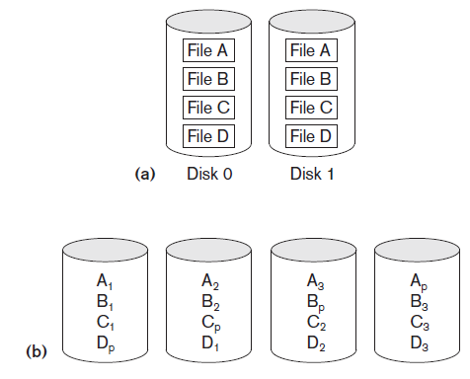
RAID Levels
Figure 16.14 Some popular levels of RAID (a) RAID level 1: Mirroring of data on two disks (b) RAID level 5: Striping of data with distributed parity across four disks

Slide 37
16.11 Modern Storage Architectures
Storage area networks
  Online storage peripherals configured as nodes on high-speed network
Network-attached storage
  Servers used for file sharing
  High degree of scalability, reliability, flexibility, performance
iSCSI
  Clients send SCSI commands to SCSI storage devices on remote channels

Slide 38
Modern Storage Architectures (cont’d.)
Fibre Channel over IP (FCIP)
  Fibre Channel control codes and data translated into IP packets
  Transmitted between geographically distant Fibre Channel SANs
Fibre Channel over Ethernet (FCoE)
  Similar to iSCSI without the IP

Slide 39
Modern Storage Architectures (cont’d.)
Automated storage tiering
  Automatically moves data between different storage types depending on need
    Frequently-used data moved to solid-state drives
Object-based storage
  Data managed in form of objects rather than files made of blocks
  Objects carry metadata and global identifier
  Ideally suited for scalable storage of unstructured data

Slide 40
16.12 Summary
Magnetic disks
  Accessing a disk block is expensive
Commands for accessing file records
File organizations: unordered, ordered, hashed
RAID
Modern storage trends

