Slide 1
Chapter 7
More SQL: Complex Queries, Triggers, Views, and Schema Modification

Slide 2
Outline
More Complex SQL Retrieval Queries
Specifying Semantic Constraints as Assertions and Actions as Triggers
Views (Virtual Tables) in SQL
Schema Modification in SQL

Slide 3
Comparisons Involving NULL and Three-Valued Logic
Meanings of NULL
  Unknown value
  Unavailable or withheld value
  Not applicable attribute
Each individual NULL value considered to be different from every other NULL value
SQL uses a three-valued logic:
  TRUE, FALSE, and UNKNOWN (like Maybe)
NULL = NULL comparison is avoided

Slide 4
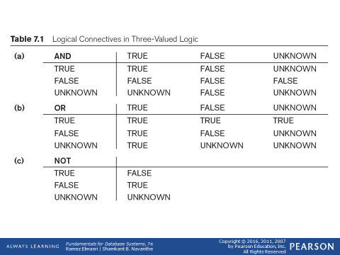
Comparisons Involving NULL and Three-Valued Logic (cont’d.)

Slide 5

Comparisons Involving NULL and Three-Valued Logic (cont’d.)
SQL allows queries that check whether an attribute value is NULL
  IS or IS NOT NULL

Slide 6
Nested Queries, Tuples, and Set/Multiset Comparisons
Nested queries
  Complete select-from-where blocks within WHERE clause of another query
  Outer query and nested subqueries
Comparison operator IN
  Compares value v with a set (or multiset) of values V
  Evaluates to TRUE if v is one of the elements in V

Slide 7
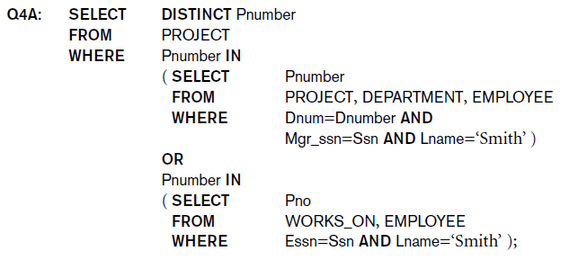
Nested Queries (cont’d.)

Slide 8
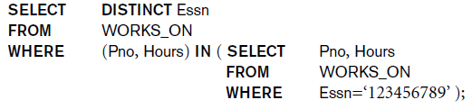
Nested Queries (cont’d.)
Use tuples of values in comparisons
  Place them within parentheses

Slide 9
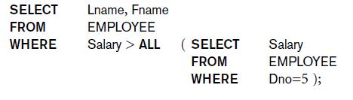
Nested Queries (cont’d.)
Use other comparison operators to compare a single value v
  = ANY (or = SOME) operator
    Returns TRUE if the value v is equal to some value in the set V and is hence equivalent to IN
  Other operators that can be combined with ANY (or SOME): >, >=, <, <=, and <>
  ALL: value must exceed all values from nested query

Slide 10
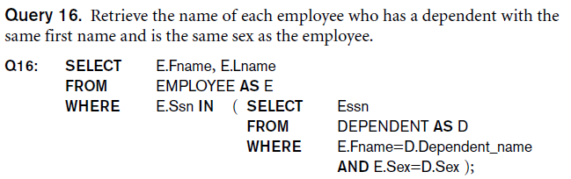
Nested Queries (cont’d.)
Avoid potential errors and ambiguities
  Create tuple variables (aliases) for all tables referenced in SQL query

Slide 11
Correlated Nested Queries
Queries that are nested using the = or IN comparison operator can be collapsed into one single block: E.g., Q16 can be written as:
Q16A: SELECT E.Fname, E.Lname
FROM EMPLOYEE AS E, DEPENDENT AS D
WHERE E.Ssn=D.Essn AND E.Sex=D.Sex
AND E.Fname=D.Dependent_name;
Correlated nested query
  Evaluated once for each tuple in the outer query

Slide 12
Correlated Nested Queries
A correlated subquery is a subquery that contains a reference to a table that also appears in the outer query

Slide 13
The EXISTS and UNIQUE Functions in SQL for correlating queries
EXISTS function
  Check whether the result of a correlated nested query is empty or not. They are Boolean functions that return a TRUE or FALSE result.
EXISTS and NOT EXISTS
  Typically used in conjunction with a correlated nested query
SQL function UNIQUE(Q)
  Returns TRUE if there are no duplicate tuples in the result of query Q

Slide 14
USE of EXISTS
Q7:
SELECT Fname, Lname
FROM Employee
WHERE EXISTS (SELECT *
FROM DEPENDENT
WHERE Ssn= Essn)
AND EXISTS (SELECT *
FROM Department
WHERE Ssn= Mgr_Ssn)

Slide 15
USE of NOT EXISTS
To achieve the “for all” effect, we use double negation this way in SQL:
Query: List first and last name of employees who work on ALL projects controlled by Dno=5.
SELECT Fname, Lname
FROM Employee
WHERE NOT EXISTS ( (SELECT Pnumber
FROM PROJECT
WHERE Dno=5)
EXCEPT (SELECT Pno
FROM WORKS_ON
WHERE Ssn= ESsn)
The above is equivalent to double negation: List names of those employees for whom there does NOT exist a project managed by department no. 5 that they do NOT work on.

Slide 16
Double Negation to accomplish “for all” in SQL
Q3B: SELECT Lname, Fname
FROM EMPLOYEE
WHERE NOT EXISTS ( SELECT *
FROM WORKS_ON B
WHERE ( B.Pno IN ( SELECT Pnumber
FROM PROJECT
WHERE Dnum=5 AND
NOT EXISTS (SELECT *
FROM WORKS_ON C
WHERE C.Essn=Ssn
AND C.Pno=B.Pno )));
The above is a direct rendering of: List names of those employees for whom there does NOT exist a project managed by department no. 5 that they do NOT work on.

Slide 17

Explicit Sets and Renaming of Attributes in SQL
Can use explicit set of values in WHERE clause
Q17: SELECT DISTINCT Essn
FROM WORKS_ON
WHERE Pno IN (1, 2, 3);
Use qualifier AS followed by desired new name
  Rename any attribute that appears in the result of a query

Slide 18

Specifying Joined Tables in the FROM Clause of SQL
Joined table
  Permits users to specify a table resulting from a join operation in the FROM clause of a query
The FROM clause in Q1A
  Contains a single joined table. JOIN may also be called INNER JOIN

Slide 19
Different Types of JOINed Tables in SQL
A JOIN clause is used to combine rows from two or more tables, based on a related column between the columns.
Joined table
  Permits users to specify a table resulting from a join operation in the FROM clause of a query
The FROM clause in Q1A
  Contains a single joined table. JOIN may also be called INNER JOIN

Slide 20
Different Types of JOINed Tables in SQL
Specify different types of join
  NATURAL JOIN
  Various types of OUTER JOIN (LEFT, RIGHT, FULL )
NATURAL JOIN on two relations R and S
  No join condition specified
  Is equivalent to an implicit EQUIJOIN condition for each pair of attributes with same name from R and S

Slide 21
Types of Joins in MySQL
INNER JOIN: Returns records that have matching values in both tables
LEFT JOIN: Returns all records from the left table, and the matched records from the right table
RIGHT JOIN: Returns all records from the right table, and the matched records from the left table
CROSS JOIN: Returns all records from both tables

Slide 22
INNER and OUTER Joins
INNER JOIN (versus OUTER JOIN)
  Default type of join in a joined table
  Tuple is included in the result only if a matching tuple exists in the other relation
LEFT OUTER JOIN
  Every tuple in left table must appear in result
  If no matching tuple
    Padded with NULL values for attributes of right table
RIGHT OUTER JOIN
  Every tuple in right table must appear in result
  If no matching tuple
    Padded with NULL values for attributes of left table

Slide 23
Example: LEFT OUTER JOIN
SELECT E.Lname AS Employee_Name
S.Lname AS Supervisor_Name
FROM Employee AS E LEFT OUTER JOIN EMPLOYEE AS S
ON E.Super_ssn = S.Ssn)
ALTERNATE SYNTAX:
SELECT E.Lname , S.Lname
FROM EMPLOYEE E, EMPLOYEE S
WHERE E.Super_ssn + = S.Ssn

Slide 24
Multiway JOIN in the FROM clause
FULL OUTER JOIN – combines result if LEFT and RIGHT OUTER JOIN
Can nest JOIN specifications for a multiway join:
Q2A: SELECT Pnumber, Dnum, Lname, Address, Bdate
FROM ((PROJECT JOIN DEPARTMENT ON Dnum=Dnumber) JOIN EMPLOYEE ON Mgr_ssn=Ssn)
WHERE Plocation=‘Stafford’;

Slide 25
Aggregate Functions in SQL
Used to summarize information from multiple tuples into a single-tuple summary
Built-in aggregate functions
  COUNT, SUM, MAX, MIN, and AVG
Grouping
  Create subgroups of tuples before summarizing
To select entire groups, HAVING clause is used
Aggregate functions can be used in the SELECT clause or in a HAVING clause

Slide 26
Renaming Results of Aggregation
Following query returns a single row of computed values from EMPLOYEE table:
Q19: SELECT SUM (Salary), MAX (Salary), MIN (Salary), AVG (Salary)
FROM EMPLOYEE;
The result can be presented with new names:
Q19A: SELECT SUM (Salary) AS Total_Sal, MAX (Salary) AS Highest_Sal, MIN (Salary) AS Lowest_Sal, AVG (Salary) AS Average_Sal
FROM EMPLOYEE;

Slide 27
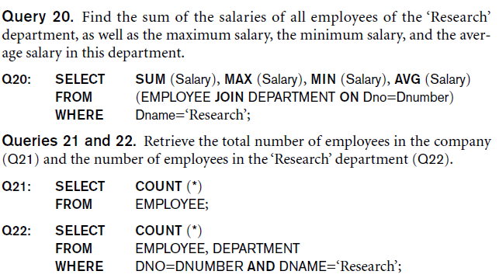
Aggregate Functions in SQL (cont’d.)
NULL values are discarded when aggregate functions are applied to a particular column

Slide 28
Grouping: The GROUP BY Clause
Partition relation into subsets of tuples
Based on grouping attribute(s)
Apply function to each such group independently
GROUP BY clause
Specifies grouping attributes
COUNT (*) counts the number of rows in the group
The GROUP BY statement is often used with aggregate functions (COUNT(), MAX(), MIN(), SUM(), AVG()) to group the result-set by one or more columns.

Slide 29
Examples of GROUP BY
The grouping attribute must appear in the SELECT clause:
Q24: SELECT Dno, COUNT (*), AVG (Salary)
FROM EMPLOYEE
GROUP BY Dno;
If the grouping attribute has NULL as a possible value, then a separate group is created for the null value (e.g., null Dno in the above query)
GROUP BY may be applied to the result of a JOIN:
Q25: SELECT Pnumber, Pname, COUNT (*)
FROM PROJECT, WORKS_ON
WHERE Pnumber=Pno
GROUP BY Pnumber, Pname;

Slide 30
Grouping: The GROUP BY and HAVING Clauses (cont’d.)
The HAVING clause was added to SQL because the WHERE keyword cannot be used with aggregate functions.
HAVING clause places conditions on groups created by the GROUP BY clause.
The HAVING clause must follow the GROUP BY clause in a query and must also precede the ORDER BY clause if used.
HAVING clause
  Provides a condition to select or reject an entire group:
Query 26. For each project on which more than two employees work, retrieve the project number, the project name, and the number of employees who work on the project.
Q26: SELECT Pnumber, Pname, COUNT (*)
FROM PROJECT, WORKS_ON
WHERE Pnumber=Pno
GROUP BY Pnumber, Pname
HAVING COUNT (*) > 2;

Slide 31
Combining the WHERE and the HAVING Clause
Consider the query: we want to count the total number of employees whose salaries exceed $40,000 in each department, but only for departments where more than five employees work.
INCORRECT QUERY:
    SELECT Dno, COUNT (*)
    FROM EMPLOYEE
    WHERE Salary>40000
    GROUP BY Dno
    HAVING COUNT (*) > 5;

Slide 32
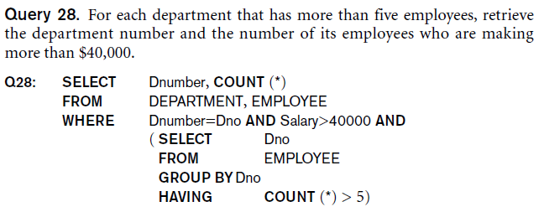
Combining the WHERE and the HAVING Clause (continued)
Correct Specification of the Query:
Note: the WHERE clause applies tuple by tuple whereas HAVING applies to entire group of tuples

Slide 33
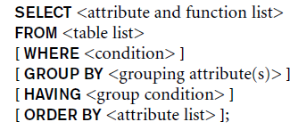
EXPANDED Block Structure of SQL Queries

Slide 34
Specifying Constraints as Assertions and Actions as Triggers
Semantic Constraints: The following are beyond the scope of the EER and relational model
CREATE ASSERTION
  Specify additional types of constraints outside scope of built-in relational model constraints
CREATE TRIGGER
  Specify automatic actions that database system will perform when certain events and conditions occur

Slide 35
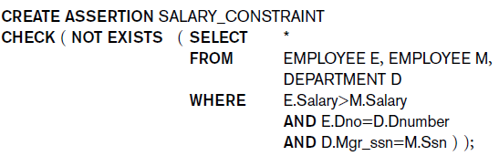
Specifying General Constraints as Assertions in SQL
CREATE ASSERTION
  Specify a query that selects any tuples that violate the desired condition
  Use only in cases where it goes beyond a simple CHECK which applies to individual attributes and domains

Slide 36
Introduction to Triggers in SQL
CREATE TRIGGER statement
  Used to monitor the database
Typical trigger has three components which make it a rule for an “active database “ (more on active databases in section 26.1) :
  Event(s)
  Condition
  Action

Slide 37
USE OF TRIGGERS
R5:
CREATE TRIGGER SALARY_VIOLATION
BEFORE INSERT OR UPDATE OF Salary, Supervisor_ssn ON EMPLOYEE
FOR EACH ROW
WHEN (NEW.SALARY > ( SELECT Salary FROM EMPLOYEE
WHERE Ssn = NEW. Supervisor_Ssn)) INFORM_SUPERVISOR (NEW.Supervisor.Ssn, New.Ssn)

Slide 38
Views (Virtual Tables) in SQL
Single table derived from other tables called the defining tables
Considered to be a virtual table that is not necessarily populated

Slide 39
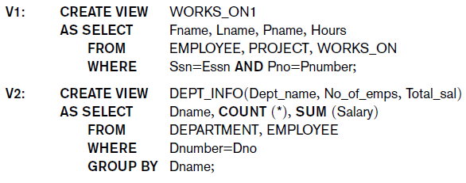
Specification of Views in SQL
CREATE VIEW command
  Give table name, list of attribute names, and a query to specify the contents of the view
  In V1, attributes retain the names from base tables. In V2, attributes are assigned names

Slide 40
Specification of Views in SQL (cont’d.)
Once a View is defined, SQL queries can use the View relation in the FROM clause
View is always up-to-date
  Responsibility of the DBMS and not the user
DROP VIEW command
  Dispose of a view

Slide 41
View Implementation, View Update, and Inline Views
Complex problem of efficiently implementing a view for querying
Strategy1: Query modification approach
  Compute the view as and when needed. Do not store permanently
  Modify view query into a query on underlying base tables
  Disadvantage: inefficient for views defined via complex queries that are time-consuming to execute

Slide 42
View Materialization
Strategy 2: View materialization
  Physically create a temporary view table when the view is first queried
  Keep that table on the assumption that other queries on the view will follow
  Requires efficient strategy for automatically updating the view table when the base tables are updated
Incremental update strategy for materialized views
  DBMS determines what new tuples must be inserted, deleted, or modified in a materialized view table

Slide 43
View Materialization (contd.)
Multiple ways to handle materialization:
  immediate update strategy updates a view as soon as the base tables are changed
  lazy update strategy updates the view when needed by a view query
  periodic update strategy updates the view periodically (in the latter strategy, a view query may get a result that is not up-to-date). This is commonly used in Banks, Retail store operations, etc.

Slide 44
View Update
Update on a view defined on a single table without any aggregate functions
  Can be mapped to an update on underlying base table- possible if the primary key is preserved in the view
Update not permitted on aggregate views. E.g.,
UV2: UPDATE DEPT_INFO
SET Total_sal=100000
WHERE Dname=‘Research’;
cannot be processed because Total_sal is a computed value in the view definition

Slide 45
Schema Change Statements in SQL
Schema evolution commands
  DBA may want to change the schema while the database is operational
  Does not require recompilation of the database schema

Slide 46
The DROP Command
DROP command
  Used to drop named schema elements, such as tables, domains, or constraint
Drop behavior options:
  CASCADE and RESTRICT
Example:
  DROP SCHEMA COMPANY CASCADE;
  This removes the schema and all its elements including tables,views, constraints, etc.

Slide 47
The ALTER table command
Alter table actions include:
  Adding or dropping a column (attribute)
  Changing a column definition
  Adding or dropping table constraints
Example:
  ALTER TABLE COMPANY.EMPLOYEE ADD COLUMN Job VARCHAR(12);

Slide 48

Adding and Dropping Constraints
Change constraints specified on a table
  Add or drop a named constraint

Slide 49
Dropping Columns, Default Values
To drop a column
  Choose either CASCADE or RESTRICT
  CASCADE would drop the column from views etc. RESTRICT is possible if no views refer to it.
ALTER TABLE COMPANY.EMPLOYEE DROP COLUMN Address CASCADE;
Default values can be dropped and altered :
  ALTER TABLE COMPANY.DEPARTMENT ALTER COLUMN Mgr_ssn DROP DEFAULT;
  ALTER TABLE COMPANY.DEPARTMENT ALTER COLUMN Mgr_ssn SET DEFAULT ‘333445555’;

Slide 50
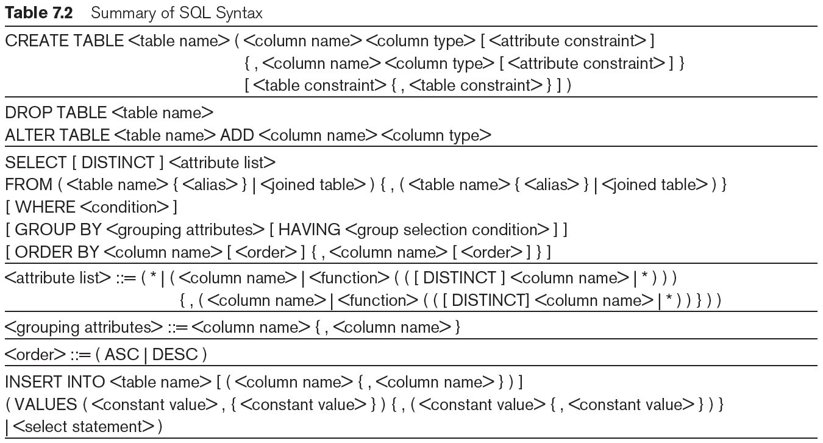
Table 7.2 Summary of SQL Syntax

Slide 51
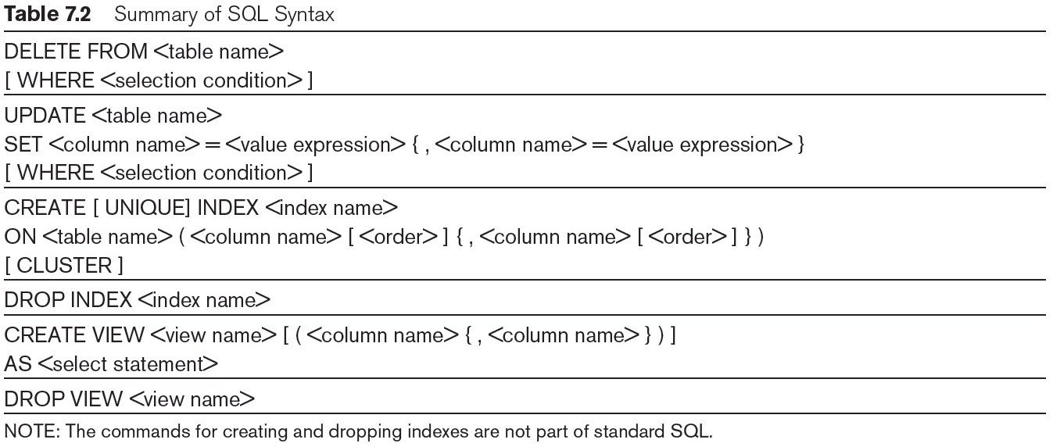
Table 7.2 (continued) Summary of SQL Syntax

Slide 52
Summary
Complex SQL:
  Nested queries, joined tables (in the FROM clause), outer joins, aggregate functions, grouping
Handling semantic constraints with CREATE ASSERTION and CREATE TRIGGER
CREATE VIEW statement and materialization strategies
Schema Modification for the DBAs using ALTER TABLE , ADD and DROP COLUMN, ALTER CONSTRAINT etc.

