Slide 1
Chapter 14: File System Implementation

Slide 2
Outline
File-System Structure
File-System Operations
Directory Implementation
Allocation Methods
Free-Space Management
Efficiency and Performance
Recovery
Example: WAFL File System

Slide 3
Objectives
Describe the details of implementing local file systems and directory structures
Discuss block allocation and free-block algorithms and trade-offs
Explore file system efficiency and performance issues
Look at recovery from file system failures
Describe the WAFL file system as a concrete example

Slide 4
File-System Structure
File structure
  Logical storage unit
  Collection of related information
File system resides on secondary storage (disks)
  Provided user interface to storage, mapping logical to physical
  Provides efficient and convenient access to disk by allowing data to be stored, located retrieved easily
Disk provides in-place rewrite and random access
  I/O transfers performed in blocks of sectors (usually 512 bytes)
File control block (FCB) – storage structure consisting of information about a file
Device driver controls the physical device
File system organized into layers

Slide 5
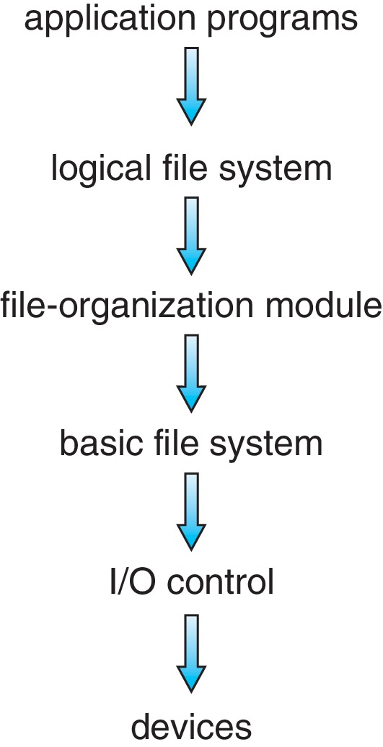
Layered File System

Slide 6
File System Layers
Device drivers manage I/O devices at the I/O control layer
  Given commands like “read drive1, cylinder 72, track 2, sector 10, into memory location 1060” outputs low-level hardware specific commands to hardware controller
Basic file system given command like “retrieve block 123” translates to device driver
Also manages memory buffers and caches (allocation, freeing, replacement)
  Buffers hold data in transit
  Caches hold frequently used data
File organization module understands files, logical address, and physical blocks
  Translates logical block # to physical block #
  Manages free space, disk allocation

Slide 7
File System Layers (Cont.)
Logical file system manages metadata information
  Translates file name into file number, file handle, location by maintaining file control blocks (inodes in UNIX)
  Directory management
  Protection
Layering useful for reducing complexity and redundancy, but adds overhead and can decrease performance
Logical layers can be implemented by any coding method according to OS designer

Slide 8
File System Layers (Cont.)
Many file systems, sometimes many within an operating system
  Each with its own format (CD-ROM is ISO 9660; Unix has UFS, FFS; Windows has FAT, FAT32, NTFS as well as floppy, CD, DVD Blu-ray, Linux has more than 130 types, with extended file system ext3 and ext4 leading; plus distributed file systems, etc.)
  New ones still arriving – ZFS, GoogleFS, Oracle ASM, FUSE

Slide 9
File-System Operations
We have system calls at the API level, but how do we implement their functions?
  On-disk and in-memory structures
Boot control block contains info needed by system to boot OS from that volume
  Needed if volume contains OS, usually first block of volume
Volume control block (superblock, master file table) contains volume details
  Total # of blocks, # of free blocks, block size, free block pointers or array
Directory structure organizes the files
  Names and inode numbers, master file table

Slide 10
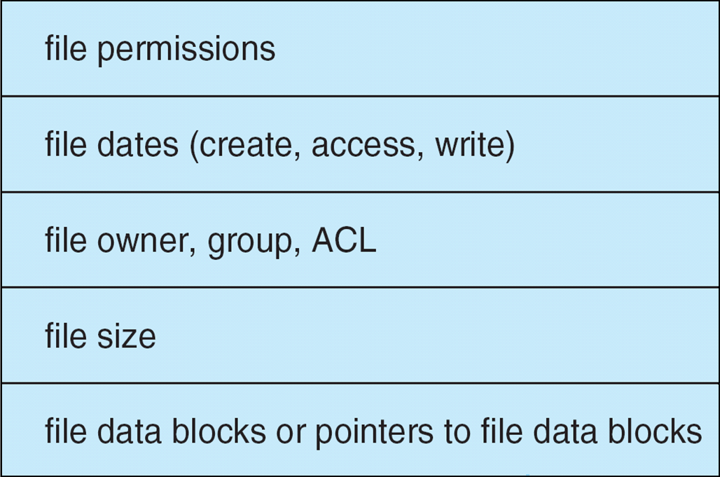
File-System Implementation (Cont.)
Per-file File Control Block (FCB) contains many details about the file
  typically inode number, permissions, size, dates
  NFTS stores into in master file table using relational DB structures

Slide 11
In-Memory File System Structures
Mount table storing file system mounts, mount points, file system types
system-wide open-file table contains a copy of the FCB of each file and other info
per-process open-file table contains pointers to appropriate entries in system-wide open-file table as well as other info
The following figure illustrates the necessary file system structures provided by the operating systems
Figure 12-3(a) refers to opening a file
Figure 12-3(b) refers to reading a file
Plus buffers hold data blocks from secondary storage
Open returns a file handle for subsequent use
Data from read eventually copied to specified user process memory address

Slide 12
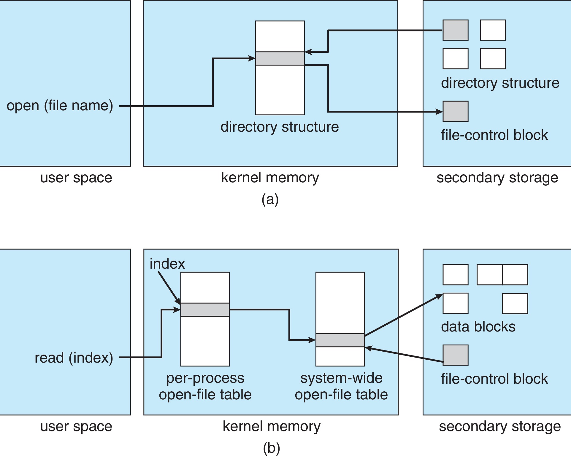
In-Memory File System Structures

Slide 13
Directory Implementation
Linear list of file names with pointer to the data blocks
  Simple to program
  Time-consuming to execute
    Linear search time
    Could keep ordered alphabetically via linked list or use B+ tree
Hash Table – linear list with hash data structure
  Decreases directory search time
  Collisions – situations where two file names hash to the same location
  Only good if entries are fixed size, or use chained-overflow method

Slide 14
Allocation Methods - Contiguous
An allocation method refers to how disk blocks are allocated for files:
Contiguous allocation – each file occupies set of contiguous blocks
  Best performance in most cases
  Simple – only starting location (block #) and length (number of blocks) are required
  Problems include finding space for file, knowing file size, external fragmentation, need for compaction off-line (downtime) or on-line

Slide 15
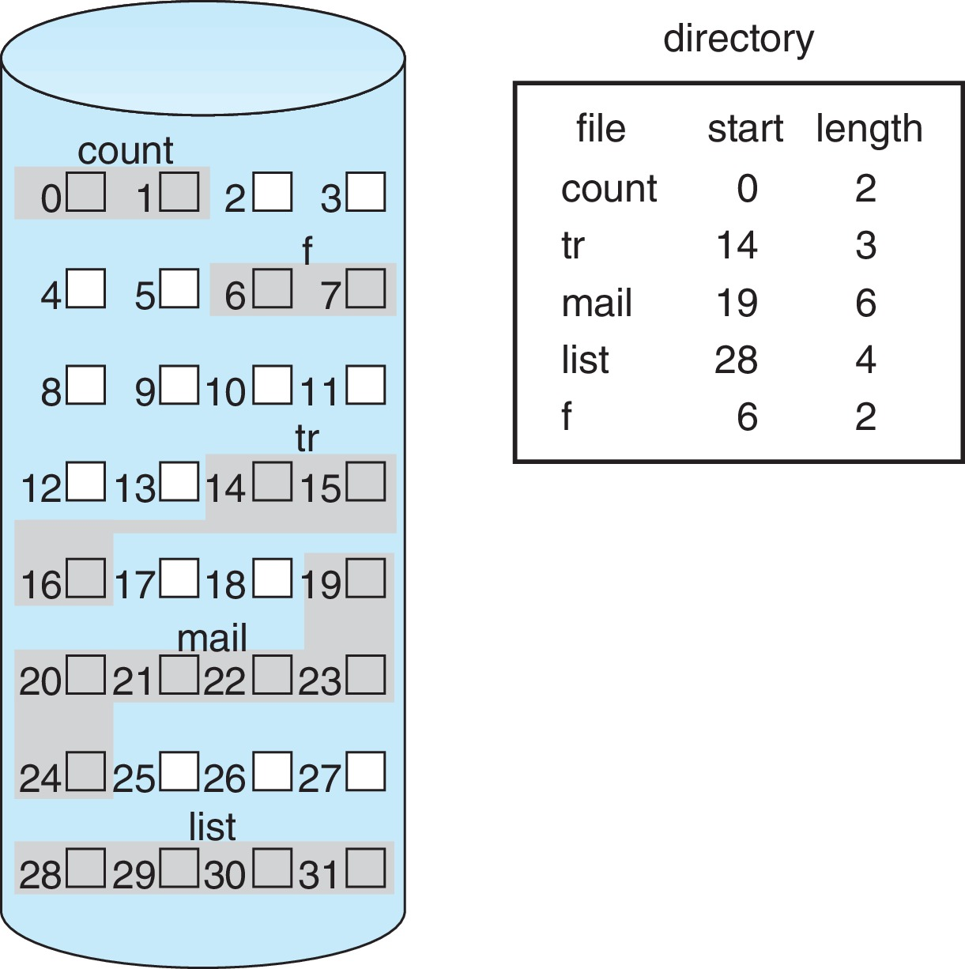
Contiguous Allocation
Mapping from logical to physical
Q
LA/512
R
  Block to be accessed = Q + starting address
  Displacement into block = R

Slide 16
Extent-Based Systems
Many newer file systems (i.e., Veritas File System) use a modified contiguous allocation scheme
Extent-based file systems allocate disk blocks in extents
An extent is a contiguous block of disks
  Extents are allocated for file allocation
  A file consists of one or more extents

Slide 17
Allocation Methods - Linked
Linked allocation – each file a linked list of blocks
  File ends at nil pointer
  No external fragmentation
  Each block contains pointer to next block
  No compaction, external fragmentation
  Free space management system called when new block needed
  Improve efficiency by clustering blocks into groups but increases internal fragmentation
  Reliability can be a problem
  Locating a block can take many I/Os and disk seeks

Slide 18
Allocation Methods – Linked (Cont.)
FAT (File Allocation Table) variation
  Beginning of volume has table, indexed by block number
  Much like a linked list, but faster on disk and cacheable
  New block allocation simple

Slide 19
Linked Allocation
Each file is a linked list of disk blocks: blocks may be scattered anywhere on the disk
block =
pointer
Mapping
Q
LA/511
R
  Block to be accessed is the Qth block in the linked chain of blocks representing the file.
  Displacement into block = R + 1

Slide 20
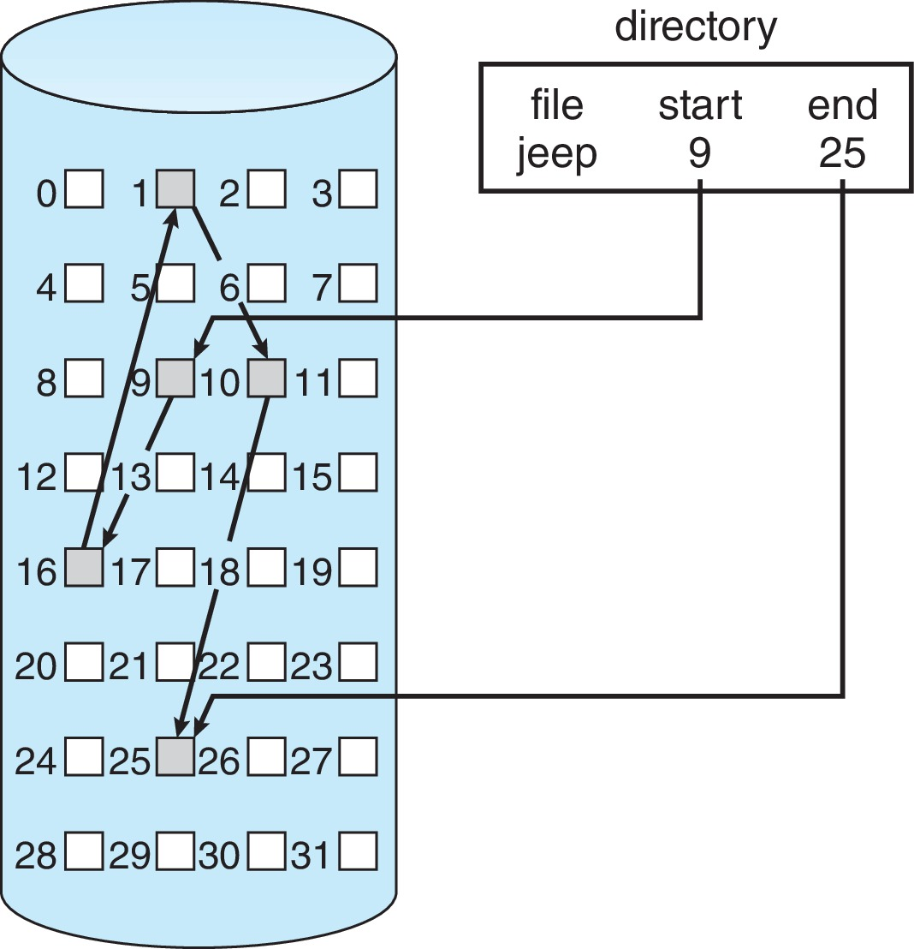
Linked Allocation

Slide 21
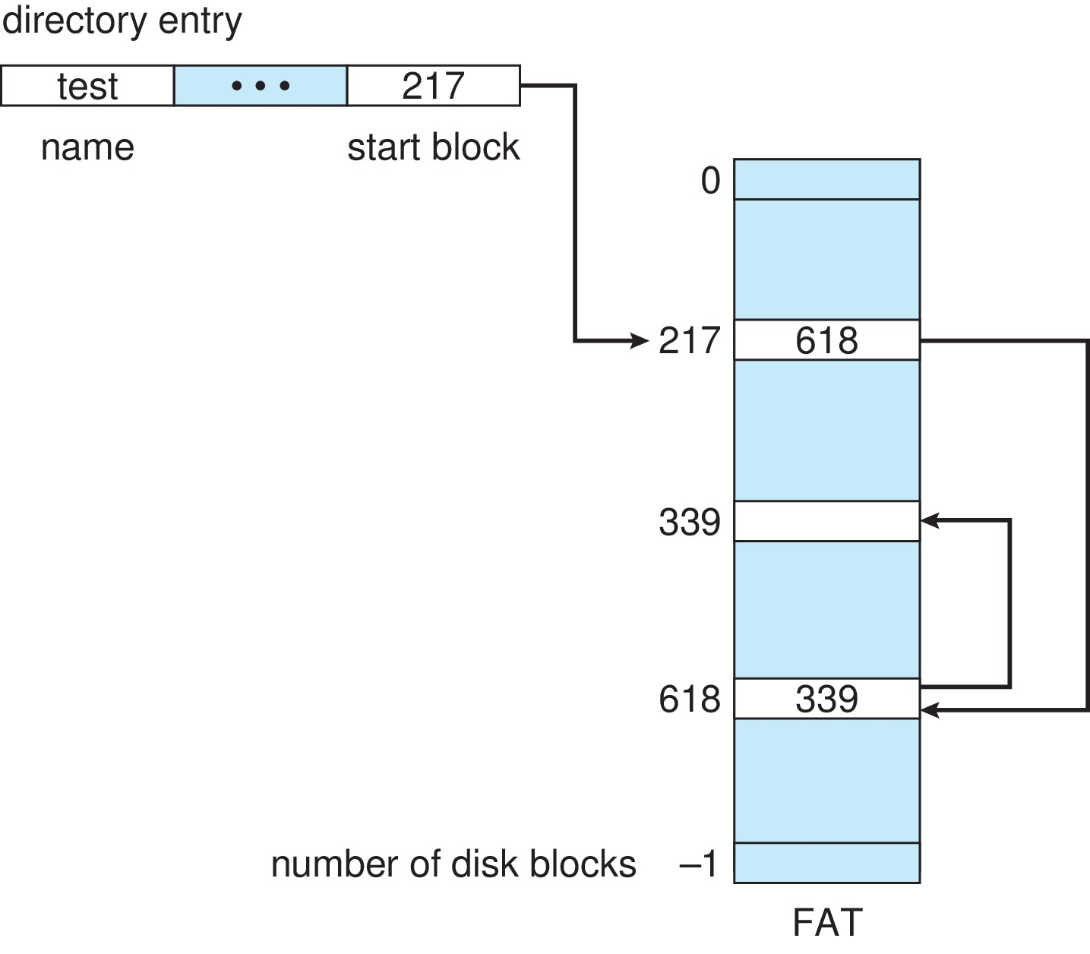
File-Allocation Table

Slide 22
Allocation Methods - Indexed
Indexed allocation
  Each file has its own index block(s) of pointers to its data blocks
Logical view

Slide 23
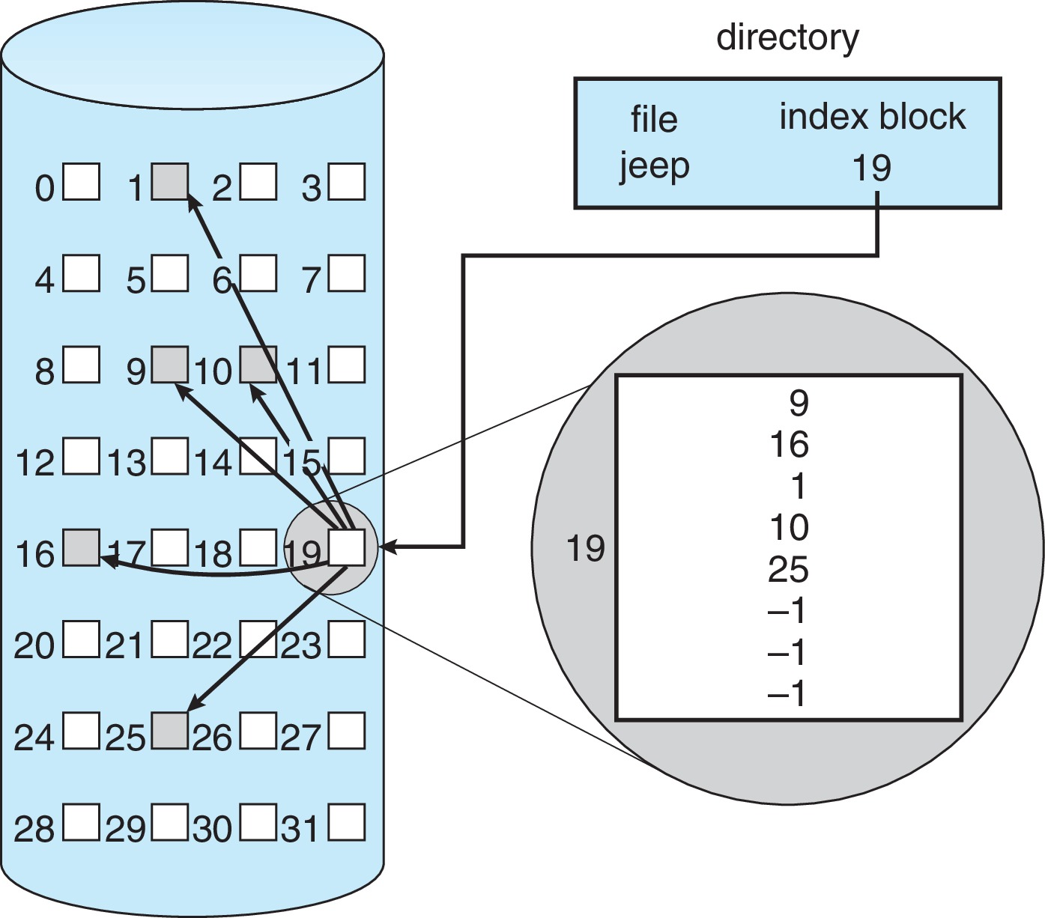
Example of Indexed Allocation

Slide 24
Indexed Allocation (Cont.)
Need index table
Random access
Dynamic access without external fragmentation, but have overhead of index block
Mapping from logical to physical in a file of maximum size of 256K bytes and block size of 512 bytes. We need only 1 block for index table
Q
LA/512
R
Q = displacement into index table
R = displacement into block

Slide 25
Indexed Allocation – Mapping (Cont.)
Mapping from logical to physical in a file of unbounded length (block size of 512 words)
Linked scheme – Link blocks of index table (no limit on size)
Q₁
LA / (512 x 511)
R₁
  Q₁ = block of index table
  R₁ is used as follows:
Q₂
R₁ / 512
R₂
  Q₂ = displacement into block of index table
  R₂ displacement into block of file:

Slide 26
Indexed Allocation – Mapping (Cont.)
Two-level index (4K blocks could store 1,024 four-byte pointers in outer index -> 1,048,567 data blocks and file size of up to 4GB)
Q₁
LA / (512 x 512)
R₁
  Q₁ = displacement into outer-index
  R₁ is used as follows:
Q₂
R₁ / 512
R₂
  Q₂ = displacement into block of index table
  R₂ displacement into block of file:

Slide 27
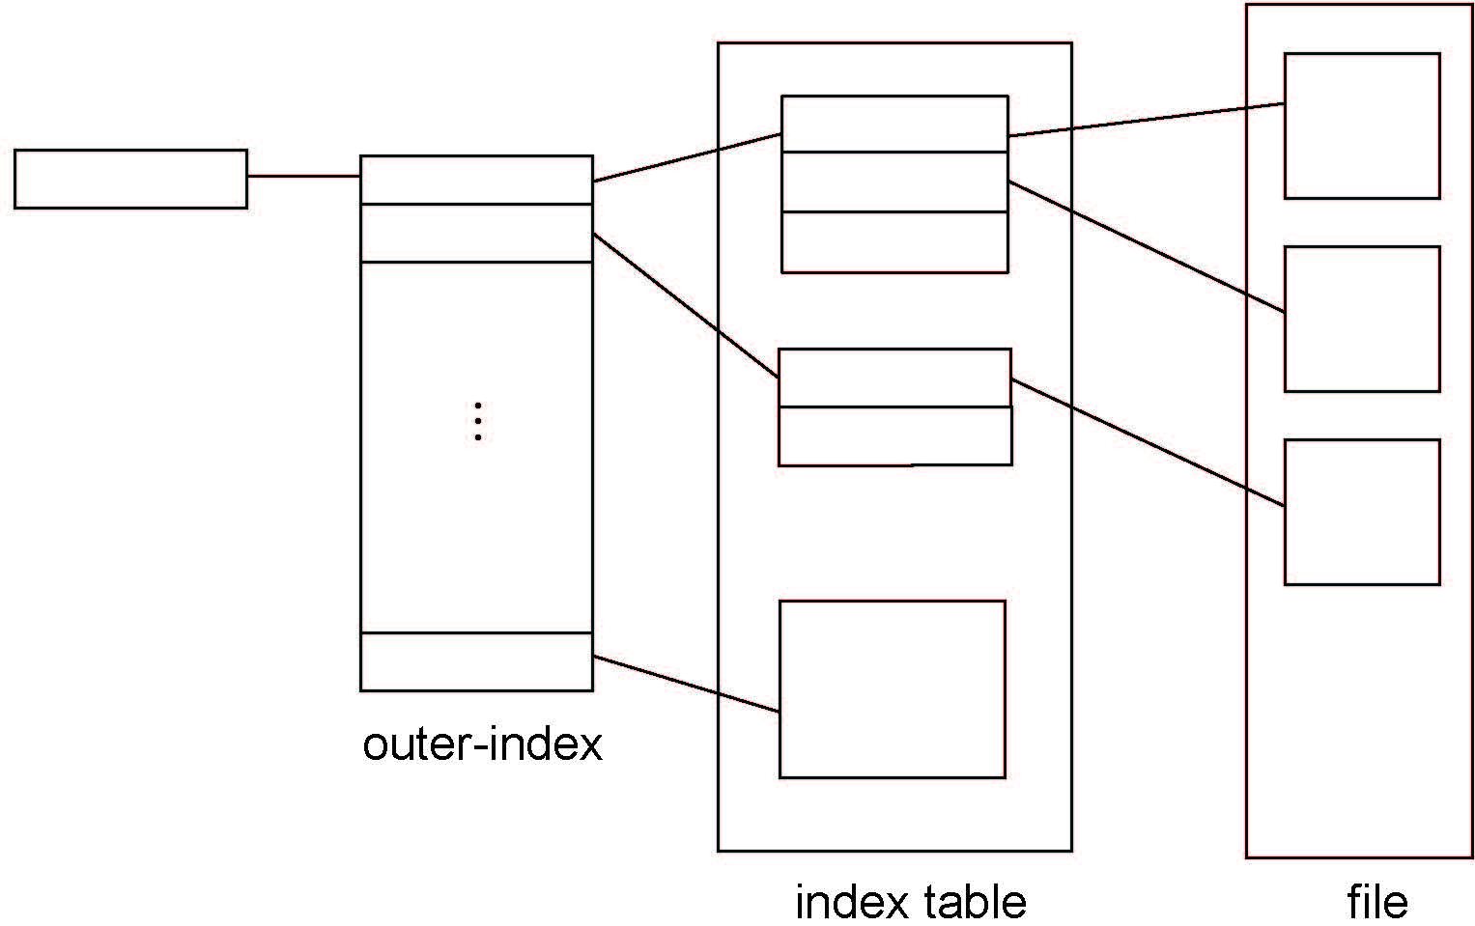
Indexed Allocation – Mapping (Cont.)

Slide 28
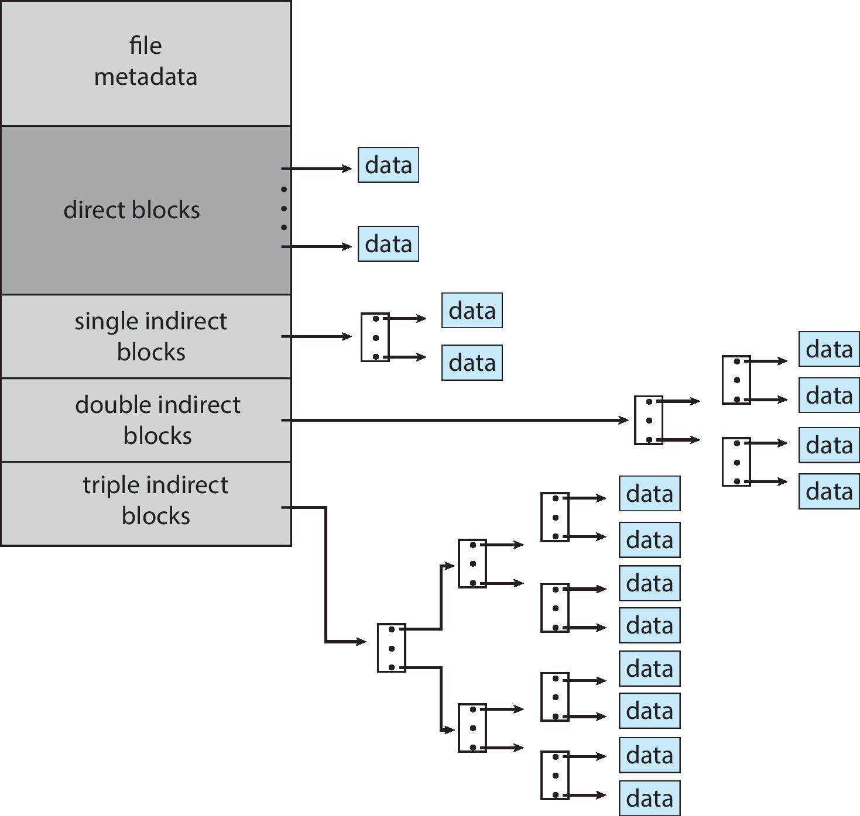
Combined Scheme: UNIX UFS
4K bytes per block, 32-bit addresses
More index blocks than can be addressed with 32-bit file pointer

Slide 29
Performance
Best method depends on file access type
  Contiguous great for sequential and random
Linked good for sequential, not random
Declare access type at creation -> select either contiguous or linked
Indexed more complex
  Single block access could require 2 index block reads then data block read
  Clustering can help improve throughput, reduce CPU overhead
For NVM, no disk head so different algorithms and optimizations needed
  Using old algorithm uses many CPU cycles trying to avoid non-existent head movement
  With NVM goal is to reduce CPU cycles and overall path needed for I/O

Slide 30
Performance (Cont.)
Adding instructions to the execution path to save one disk I/O is reasonable
  Intel Core i7 Extreme Edition 990x (2011) at 3.46Ghz = 159,000 MIPS
    http://en.wikipedia.org/wiki/Instructions_per_second
  Typical disk drive at 250 I/Os per second
    159,000 MIPS / 250 = 630 million instructions during one disk I/O
  Fast SSD drives provide 60,000 IOPS
    159,000 MIPS / 60,000 = 2.65 millions instructions during one disk I/O

Slide 31
Free-Space Management
File system maintains free-space list to track available blocks/clusters
  (Using term “block” for simplicity)
Bit vector or bit map (n blocks)
0
1
2
n-1
…
1 ⇒ block[i] free
0 ⇒ block[i] occupied
bit[i] =

Block number calculation
(number of bits per word) *
(number of 0-value words) +
offset of first 1 bit
CPUs have instructions to return offset within word of first “1” bit

Slide 32
Free-Space Management (Cont.)
Bit map requires extra space
  Example:
block size = 4KB = 2¹² bytes
disk size = 2⁴⁰ bytes (1 terabyte)
n = 2⁴⁰/2¹² = 2²⁸ bits (or 32MB)
if clusters of 4 blocks -> 8MB of memory
Easy to get contiguous files

Slide 33
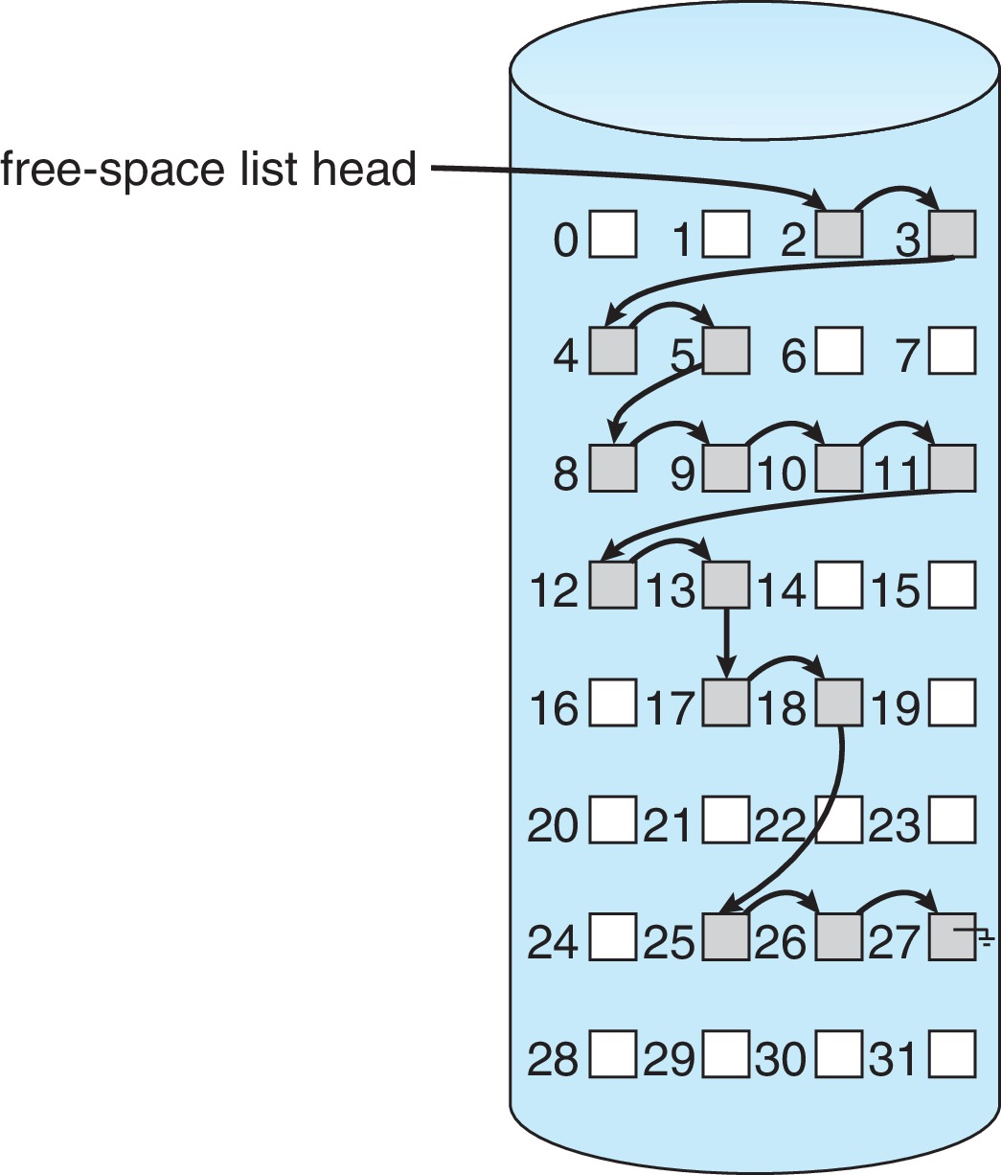
Linked Free Space List on Disk
Linked list (free list)
  Cannot get contiguous space easily
  No waste of space
  No need to traverse the entire list (if # free blocks recorded)

Slide 34
Free-Space Management (Cont.)
Grouping
  Modify linked list to store address of next n-1 free blocks in first free block, plus a pointer to next block that contains free-block-pointers (like this one)
Counting
  Because space is frequently contiguously used and freed, with contiguous-allocation allocation, extents, or clustering
    Keep address of first free block and count of following free blocks
    Free space list then has entries containing addresses and counts

Slide 35
Free-Space Management (Cont.)
Space Maps
  Used in ZFS
  Consider meta-data I/O on very large file systems
    Full data structures like bit maps couldn’t fit in memory -> thousands of I/Os
  Divides device space into metaslab units and manages metaslabs
    Given volume can contain hundreds of metaslabs
  Each metaslab has associated space map
    Uses counting algorithm
  But records to log file rather than file system
    Log of all block activity, in time order, in counting format
  Metaslab activity -> load space map into memory in balanced-tree structure, indexed by offset
    Replay log into that structure
    Combine contiguous free blocks into single entry

Slide 36
TRIMing Unused Blocks
HDDS overwrite in place so need only free list
Blocks not treated specially when freed
  Keeps its data but without any file pointers to it, until overwritten
Storage devices not allowing overwrite (like NVM) suffer badly with same algorithm
  Must be erased before written, erases made in large chunks (blocks, composed of pages) and are slow
  TRIM is a newer mechanism for the file system to inform the NVM storage device that a page is free
    Can be garbage collected or if block is free, now block can be erased

Slide 37
Efficiency and Performance
Efficiency dependent on:
  Disk allocation and directory algorithms
  Types of data kept in file’s directory entry
  Pre-allocation or as-needed allocation of metadata structures
  Fixed-size or varying-size data structures

Slide 38
Efficiency and Performance (Cont.)
Performance
  Keeping data and metadata close together
  Buffer cache – separate section of main memory for frequently used blocks
  Synchronous writes sometimes requested by apps or needed by OS
    No buffering / caching – writes must hit disk before acknowledgement
    Asynchronous writes more common, buffer-able, faster
  Free-behind and read-ahead – techniques to optimize sequential access
  Reads frequently slower than writes

Slide 39
Page Cache
A page cache caches pages rather than disk blocks using virtual memory techniques and addresses
Memory-mapped I/O uses a page cache
Routine I/O through the file system uses the buffer (disk) cache
This leads to the following figure

Slide 40
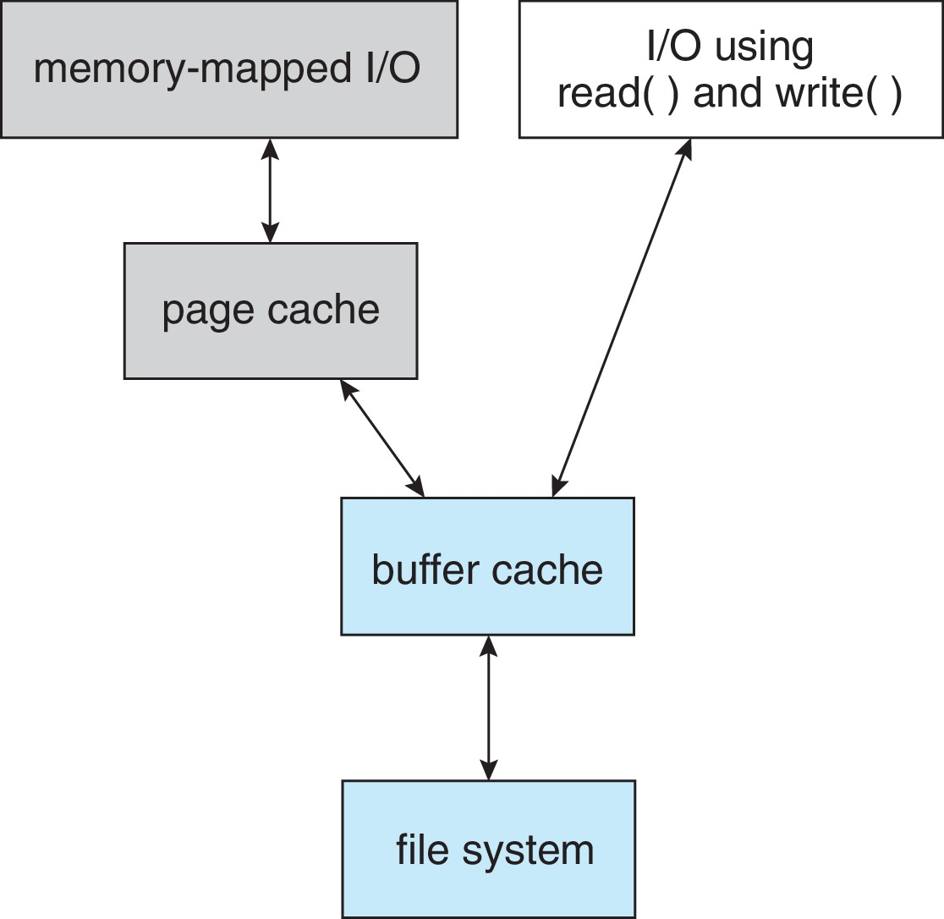
I/O Without a Unified Buffer Cache

Slide 41
Unified Buffer Cache
A unified buffer cache uses the same page cache to cache both memory-mapped pages and ordinary file system I/O to avoid double caching
  But which caches get priority, and what replacement algorithms to use?

Slide 42
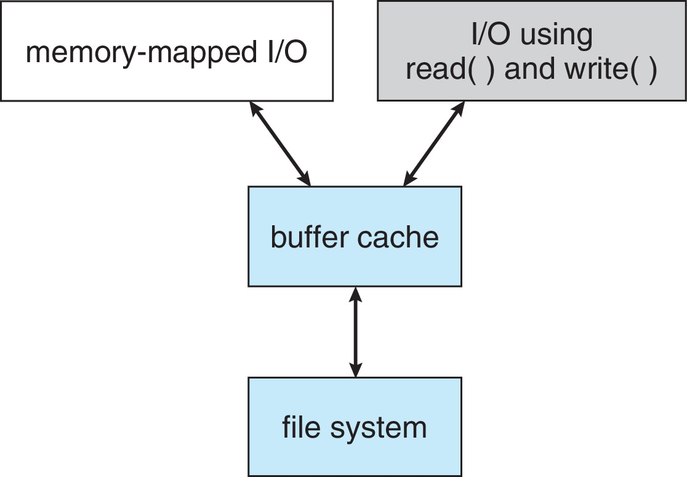
I/O Using a Unified Buffer Cache

Slide 43
Recovery
Consistency checking – compares data in directory structure with data blocks on disk, and tries to fix inconsistencies
  Can be slow and sometimes fails
Use system programs to back up data from disk to another storage device (magnetic tape, other magnetic disk, optical)
Recover lost file or disk by restoring data from backup

Slide 44
Log Structured File Systems
Log structured (or journaling) file systems record each metadata update to the file system as a transaction
All transactions are written to a log
  A transaction is considered committed once it is written to the log (sequentially)
  Sometimes to a separate device or section of disk
  However, the file system may not yet be updated
The transactions in the log are asynchronously written to the file system structures
  When the file system structures are modified, the transaction is removed from the log
If the file system crashes, all remaining transactions in the log must still be performed
Faster recovery from crash, removes chance of inconsistency of metadata

Slide 45
Example: WAFL File System
Used on Network Appliance “Filers” – distributed file system appliances
“Write-anywhere file layout”
Serves up NFS, CIFS, http, ftp
Random I/O optimized, write optimized
  NVRAM for write caching
Similar to Berkeley Fast File System, with extensive modifications

Slide 46
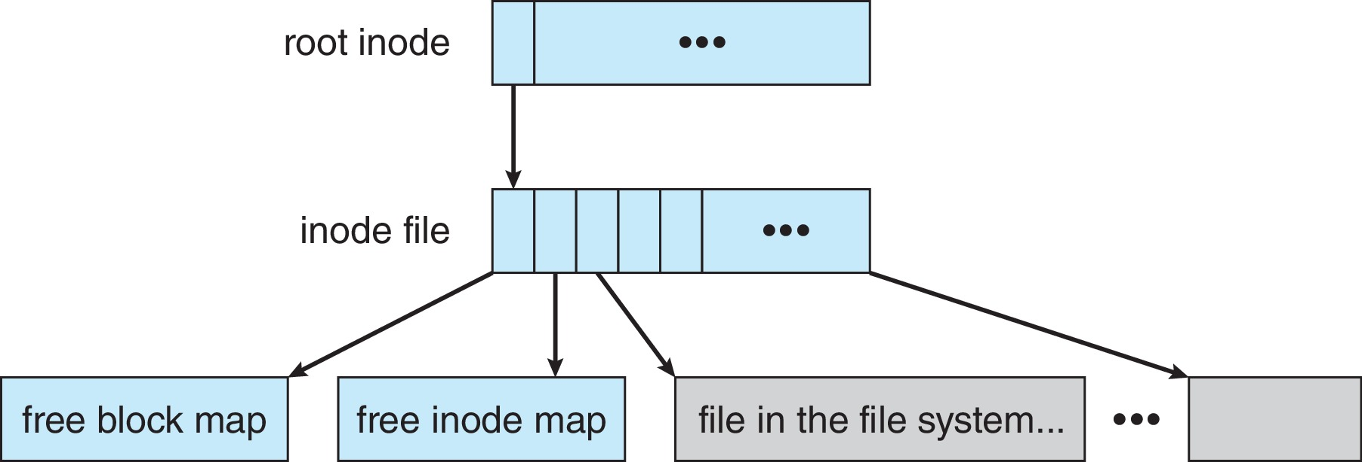
The WAFL File Layout

Slide 47
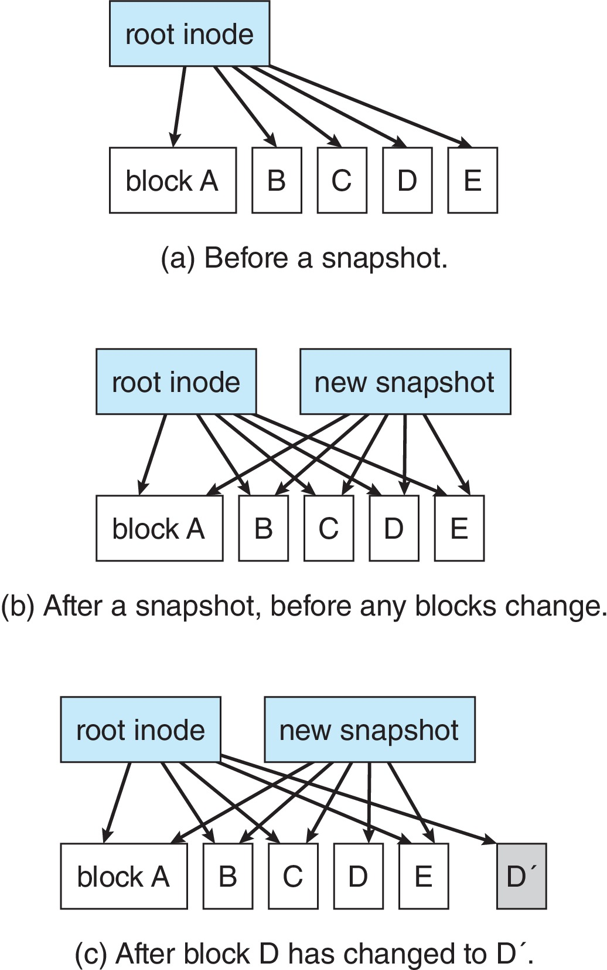
Snapshots in WAFL

Slide 48
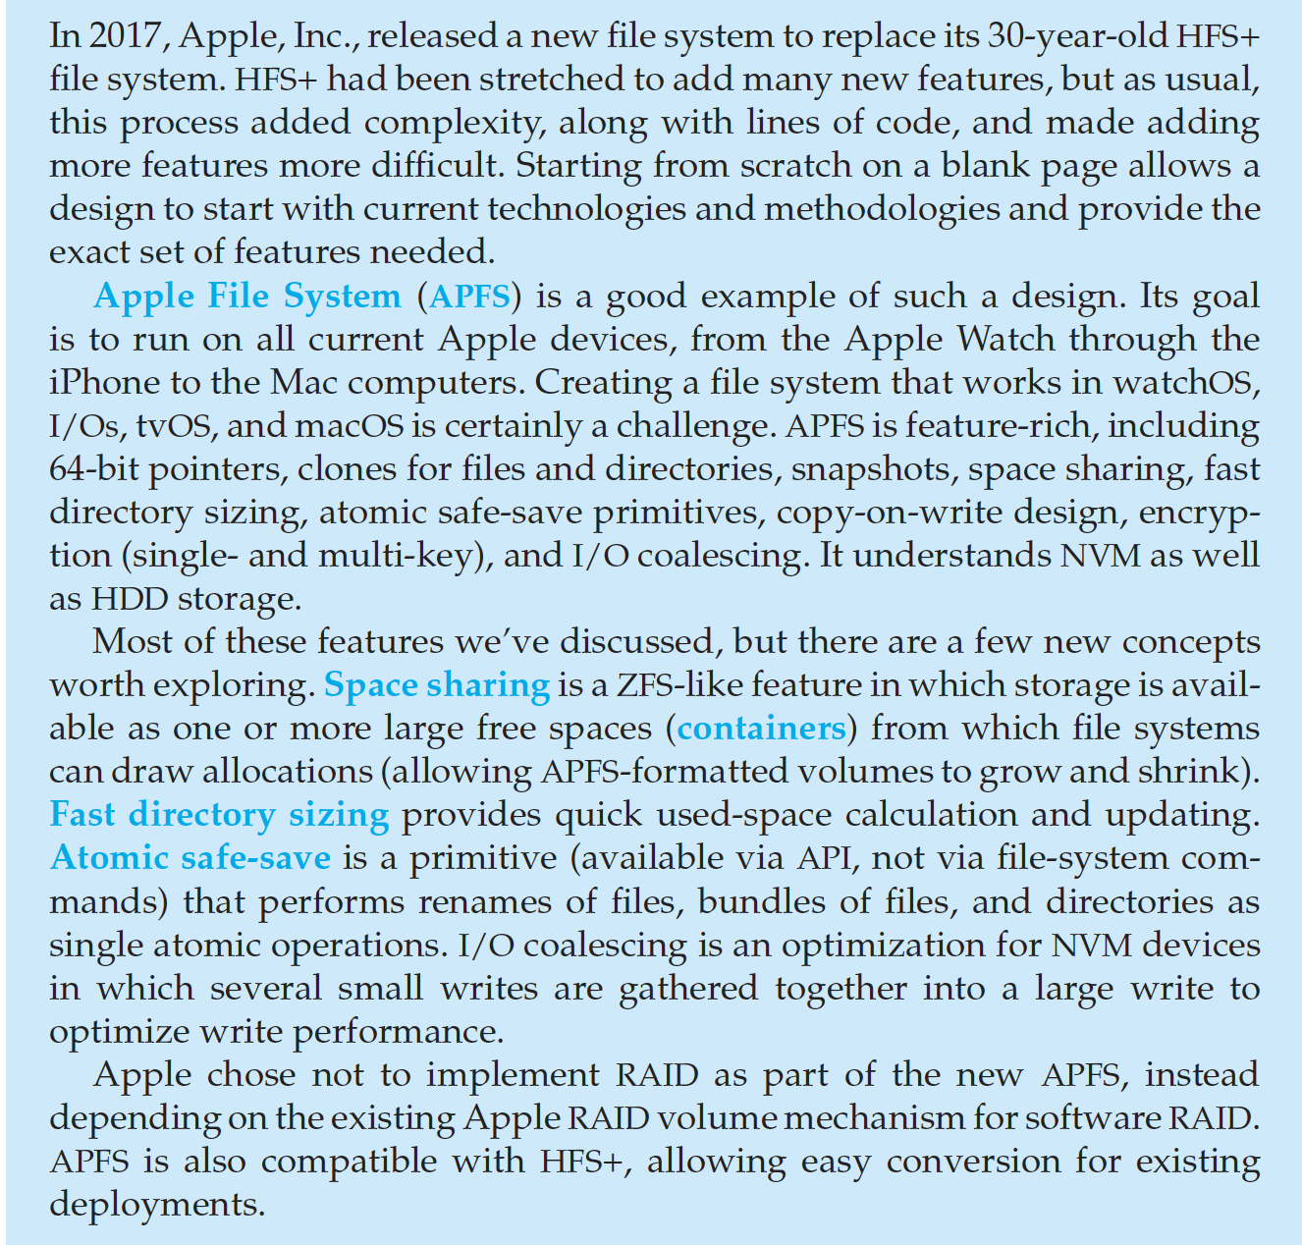
The Apple File System

Slide 49
End of Chapter 14

