Slide 1
Chapter 3
Data Modeling Using the Entity-Relationship (ER) Model

Slide 2
Outline
Overview of Database Design Process
Example Database Application (COMPANY)
ER Model Concepts
  Entities and Attributes
  Entity Types, Value Sets, and Key Attributes
  Relationships and Relationship Types
  Weak Entity Types
  Roles and Attributes in Relationship Types
ER Diagrams - Notation
ER Diagram for COMPANY Schema

Slide 3
Overview of Database Design Process
Database design process involves:
  Database design
  Applications design
This chapter focuses on conceptual database design to design the conceptual schema for a database application
  We will use entity-relationship (ER) model
Applications design focuses on the programs and interfaces that access the database. This is generally considered part of software engineering

Slide 4
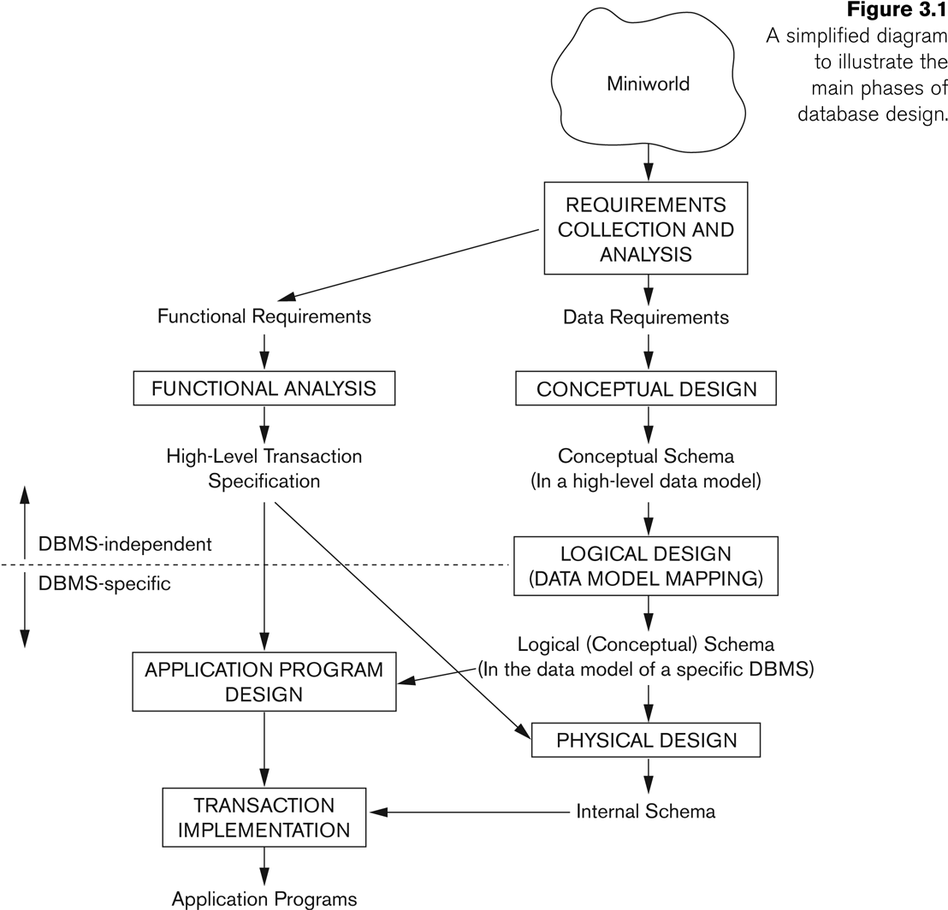
Overview of Database Design Process

Slide 5
Methodologies for Conceptual Design
WE can be able to design conceptual schemas using:
  Entity Relationship (ER) Diagrams (This Chapter)
  Enhanced Entity Relationship (EER) Diagrams (Chapter 4)
  The UML (Unified Modeling Language) Class Diagrams are popular in industry to document conceptual database designs
Use of Design Tools in industry for designing and documenting large scale designs

Slide 6
Example COMPANY Database
We need to create a database schema design based on the following (simplified) requirements of the COMPANY Database:
  The company is organized into DEPARTMENTs. Each department has a name, number and an employee who manages the department. We keep track of the start date of the department manager. A department may have several locations.
  Each department controls a number of PROJECTs. Each project has a unique name, unique number and is located at a single location.

Slide 7
Example COMPANY Database (Continued)
The database will store each EMPLOYEE’s social security number, address, salary, sex, and birthdate.
  Each employee works for one department but may work on several projects.
  The DB will keep track of the number of hours per week that an employee currently works on each project.
  It is required to keep track of the direct supervisor of each employee.
Each employee may have a number of DEPENDENTs.
  For each dependent, the DB keeps a record of name, sex, birthdate, and relationship to the employee.

Slide 8
ER Model Concepts
The ER model describes data as entities, relationships, and attributes

Slide 9
Entities and Attributes
Entity is a basic concept for the ER model. Entities are specific things or objects in the mini-world that are represented in the database.
  For example, the EMPLOYEE John Smith, the Research DEPARTMENT, the ProductX PROJECT
Attributes are properties used to describe an entity.
  For example, an EMPLOYEE entity may have the attributes Name, SSN, Address, Sex, BirthDate
A specific entity will have a value for each of its attributes.
  For example, a specific employee entity may have Name='John Smith', SSN='123456789', Address ='731, Fondren, Houston, TX', Sex='M', BirthDate='09-JAN-55‘
Each attribute has a value set (or data type) associated with it – e.g. integer, string, date, enumerated type, …

Slide 10
Types of Attributes
Simple (atomic) attribute
  Each entity has a single atomic value for the attribute. For example, SSN or Sex.
Composite attribute
  The attribute may be composed of several components. For example:
  Address(Apt#, House#, Street, City, State, ZipCode, Country), or
  Name(FirstName, MiddleName, LastName).
  Composition may form a hierarchy where some components are themselves composite.

Slide 11
Types of Attributes (Continued)
Single-valued attribute
  It is an attribute that has a single value for a particular entity. For example, age
Multi-valued attribute
  It is an attribute that can have multiple set of values for a particular entity. For example, Color of a CAR or PreviousDegrees of a STUDENT.
  Denoted as {Color} or {PreviousDegrees}.
Derived Attribute
  A derived attribute is an attribute whose value can be determined from another related attribute. For example, a person’s aga can be determined from date of birth

Slide 12
Types of Attributes (Continued)
In general, composite and multi-valued attributes may be nested arbitrarily to any number of levels, although this is rare.
  For example, PreviousDegrees of a STUDENT is a composite multi-valued attribute denoted by {PreviousDegrees (College, Year, Degree, Field)}
  Multiple PreviousDegrees values can exist
  Each has four subcomponent attributes:
    College, Year, Degree, Field

Slide 13
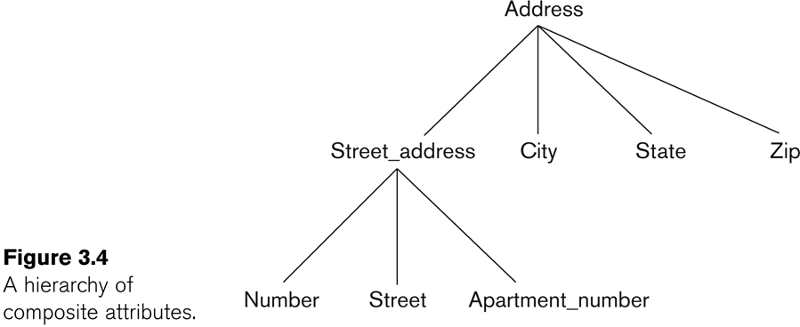
Example of a composite attribute

Slide 14
Entity Types and Key Attributes (1)
An entity type defines a collection (or set) of entities that have the same attributes
Entities with the same basic attributes are grouped or typed into an entity type.
  For example, the entity type EMPLOYEE and PROJECT.
Each entity type in the database is described by its name and attributes.
An entity type usually has one or more attributes whose values are distinct for each individual entity in the entity set. This is called a key attribute. A key attribute is an attribute of an entity type for which each entity must have a unique value.
  For example, SSN of EMPLOYEE.

Slide 15
Entity Types and Key Attributes (2)
A key attribute may be composite.
  VehicleTagNumber is a key of the CAR entity type with components (Number, State).
An entity type may have more than one key.
  The CAR entity type may have two keys:
    VehicleIdentificationNumber (popularly called VIN)
    VehicleTagNumber (Number, State), aka license plate number.
Each key is underlined (Note: this is different from the relational schema where only one “primary key is underlined).

Slide 16
Entity Set
An entity set is a collection of all entities of a particular entity type in the database at any point in time is called an entity set or entity collection.
Entity set is also called entity collection
Previous slide shows three CAR entity instances in the entity set for CAR
Same name (CAR) used to refer to both the entity type and the entity set
However, entity type and entity set may be given different names
Entity set is the current state of the entities of that type that are stored in the database

Slide 17
Value Sets (Domains) of Attributes
Specifies a set of values that may be assigned to that attribute for each individual entity.
Each simple attribute is associated with a value set
  E.g., Lastname has a value which is a character string of upto 15 characters, say
  Date has a value consisting of MM-DD-YYYY where each letter is an integer
A value set specifies the set of values associated with an attribute
Value sets are similar to data types in most programming languages – e.g., integer, character (n), real, bit

Slide 18
Displaying an Entity type in ER Diagrams
In ER diagrams, an entity type is displayed in a rectangular box
Attributes are displayed in ovals
  Each attribute is connected to its entity type
  Components of a composite attribute are connected to the oval representing the composite attribute
  Each key attribute is underlined
  Multivalued attributes displayed in double ovals

Slide 19
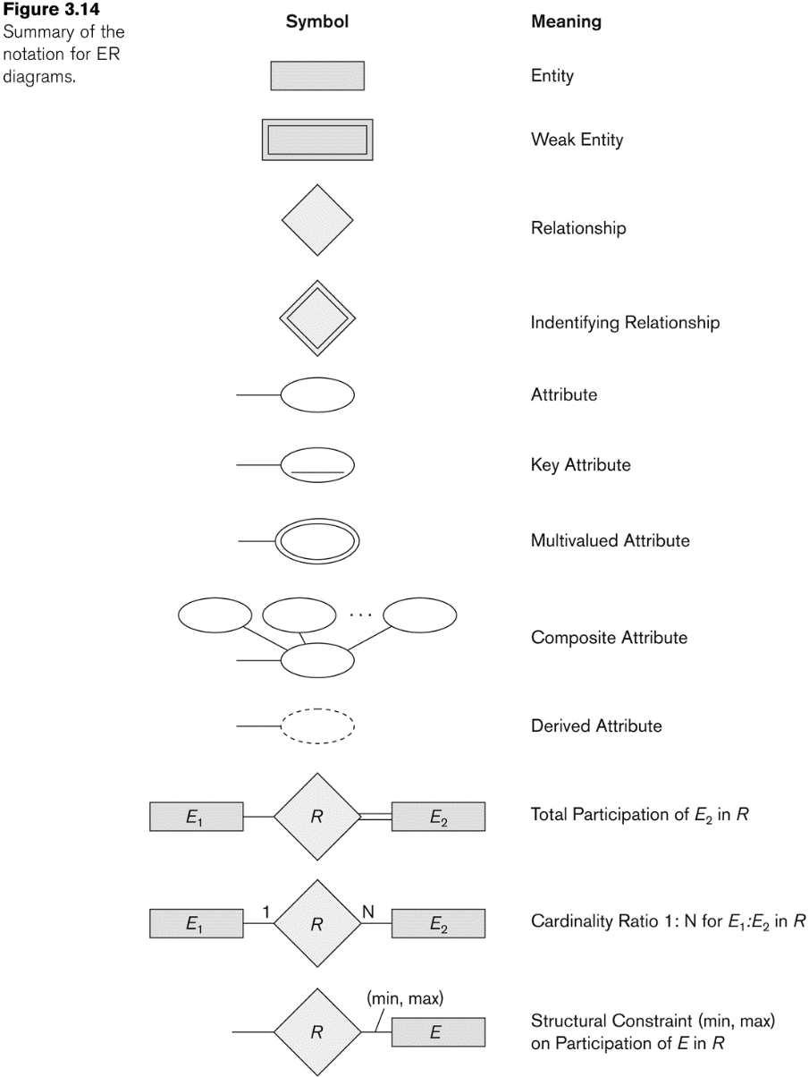
NOTATION for ER diagrams

Slide 20
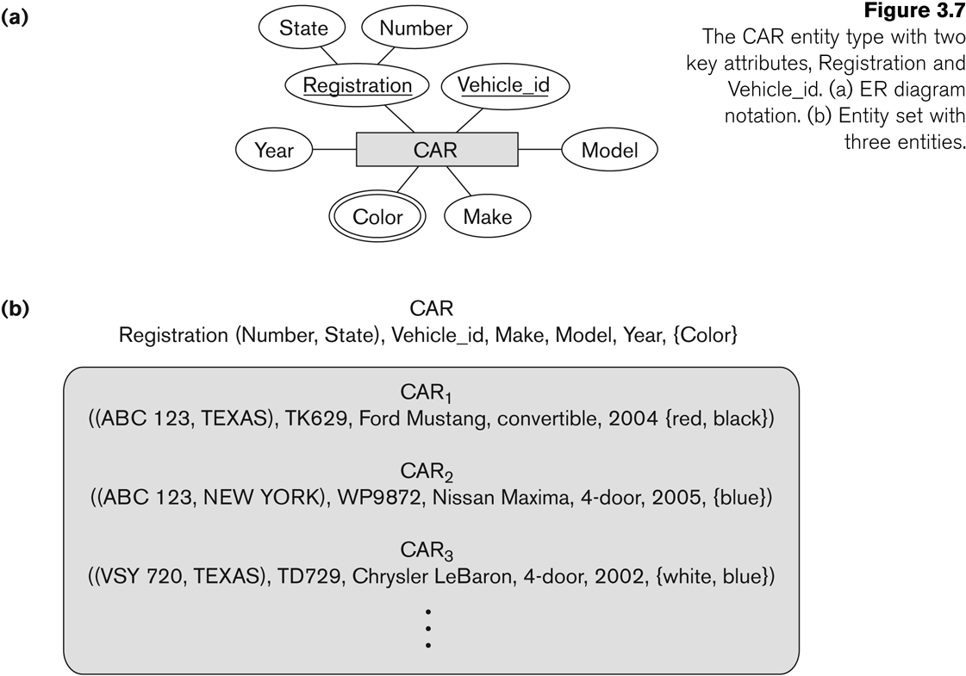
Entity Type CAR with two keys and a corresponding Entity Set

Slide 21
Initial Conceptual Design of Entity Types for the COMPANY Database Schema
Based on the requirements, we can identify four initial entity types in the COMPANY database:
  DEPARTMENT
  PROJECT
  EMPLOYEE
  DEPENDENT
Their initial conceptual design is shown on the following slide
The initial attributes shown are derived from the requirements description

Slide 22
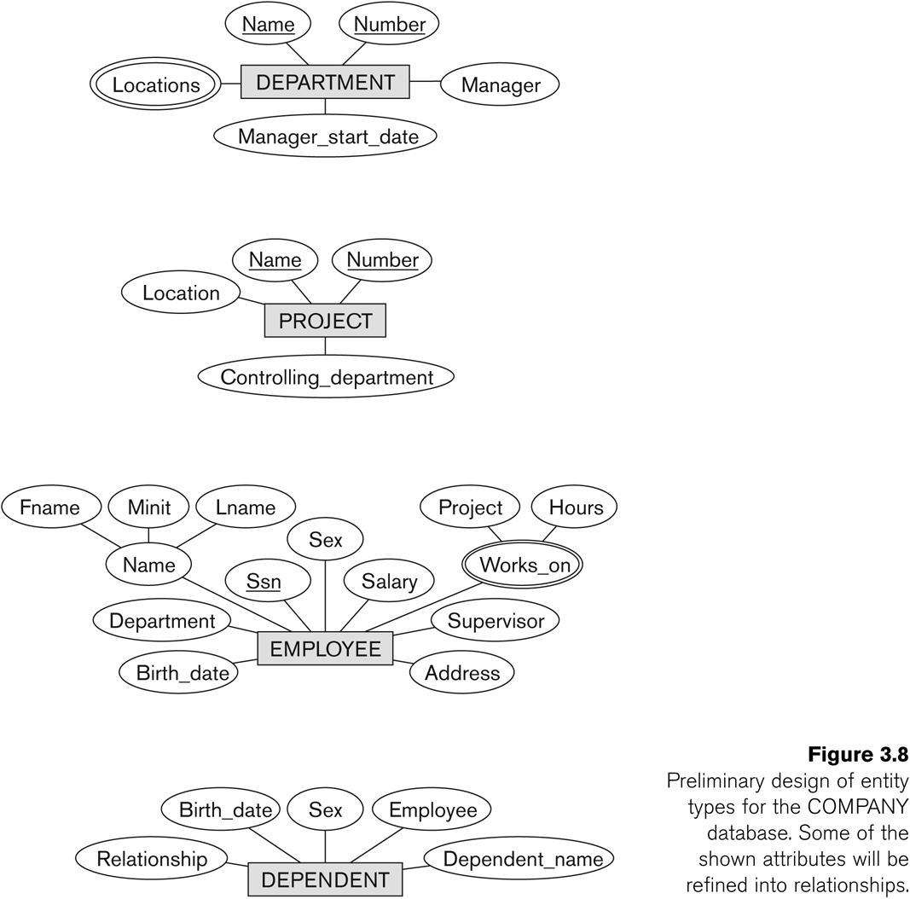
Initial Design of Entity Types: EMPLOYEE, DEPARTMENT, PROJECT, DEPENDENT

Slide 23
Refining the initial design by introducing relationships
ER model has three main concepts:
  Entities (and their entity types and entity sets)
  Attributes (simple, composite, multivalued)
  Relationships (and their relationship types and relationship sets)
The initial design is typically not complete
Some aspects in the requirements will be represented as relationships
We introduce relationship concepts next

Slide 24
Relationships and Relationship Types
A relationship relates two or more distinct entities with a specific meaning.
  For example, EMPLOYEE John Smith works on the ProductX PROJECT, or EMPLOYEE Franklin Wong manages the Research DEPARTMENT.
Relationships of the same type are grouped or typed into a relationship type.
  For example, the WORKS_ON relationship type in which EMPLOYEEs and PROJECTs participate, or the MANAGES relationship type in which EMPLOYEEs and DEPARTMENTs participate.
The degree of a relationship type is the number of participating entity types.
  Both MANAGES and WORKS_ON are binary relationships.

Slide 25
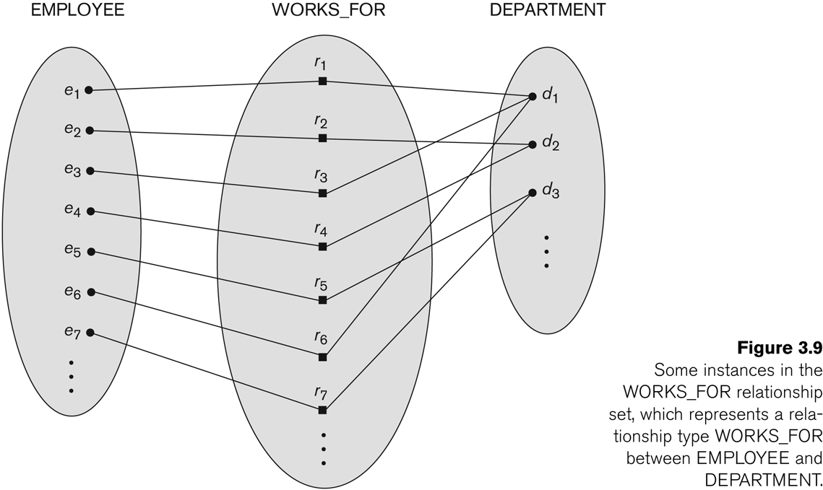
Relationship instances of the WORKS_FOR N:1 relationship between EMPLOYEE and DEPARTMENT

Slide 26
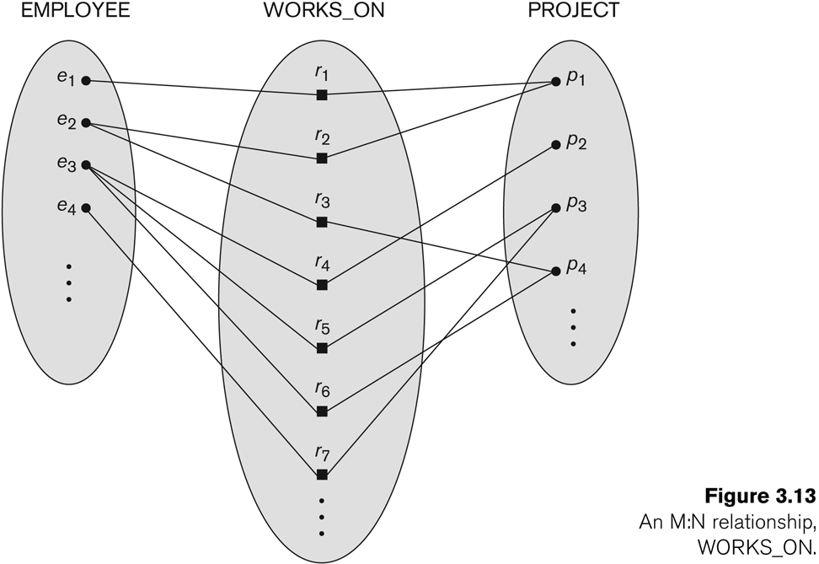
Relationship instances of the M:N WORKS_ON relationship between EMPLOYEE and PROJECT

Slide 27
Relationship type vs. relationship set (1)
Relationship Type:
  Is the schema description of a relationship
  Identifies the relationship name and the participating entity types
  Also identifies certain relationship constraints
Relationship Set:
  The current set of relationship instances represented in the database
  The current state of a relationship type

Slide 28
Relationship type vs. relationship set (2)
Previous figures displayed the relationship sets
Each instance in the set relates individual participating entities – one from each participating entity type
In ER diagrams, we represent the relationship type as follows:
  Diamond-shaped box is used to display a relationship type
  Connected to the participating entity types via straight lines
  Note that the relationship type is not shown with an arrow. The name should be typically be readable from left to right and top to bottom.

Slide 29
Refining the COMPANY database schema by introducing relationships
By examining the requirements, six relationship types are identified
All are binary relationships( degree 2)
Listed below with their participating entity types:
  WORKS_FOR (between EMPLOYEE, DEPARTMENT)
  MANAGES (also between EMPLOYEE, DEPARTMENT)
  CONTROLS (between DEPARTMENT, PROJECT)
  WORKS_ON (between EMPLOYEE, PROJECT)
  SUPERVISION (between EMPLOYEE (as subordinate), EMPLOYEE (as supervisor))
  DEPENDENTS_OF (between EMPLOYEE, DEPENDENT)

Slide 30
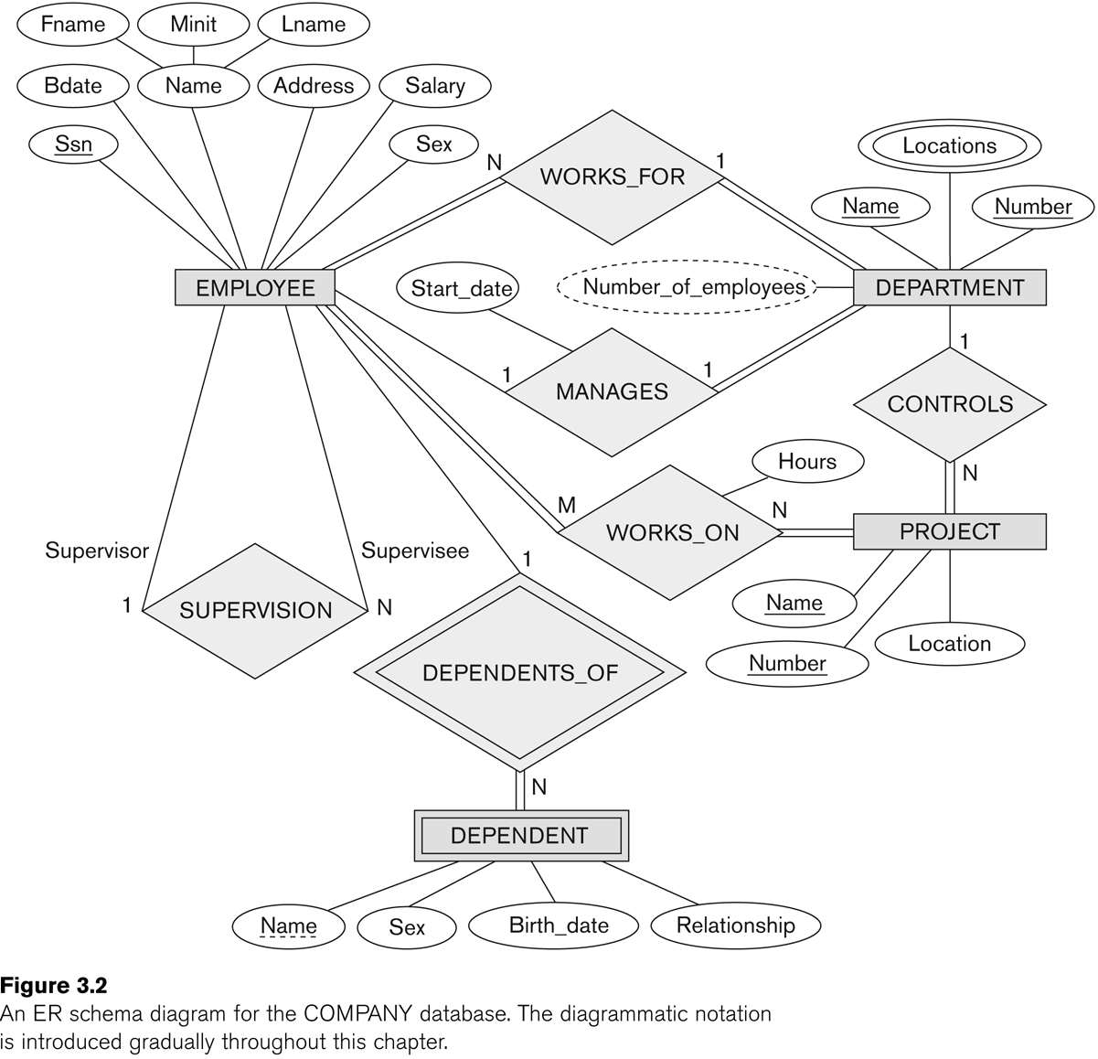
ER DIAGRAM – Relationship Types are: WORKS_FOR, MANAGES, WORKS_ON, CONTROLS, SUPERVISION, DEPENDENTS_OF

Slide 31
Discussion on Relationship Types
In the refined design, some attributes from the initial entity types are refined into relationships:
  Manager of DEPARTMENT -> MANAGES
  Works_on of EMPLOYEE -> WORKS_ON
  Department of EMPLOYEE -> WORKS_FOR
  etc
In general, more than one relationship type can exist between the same participating entity types
  MANAGES and WORKS_FOR are distinct relationship types between EMPLOYEE and DEPARTMENT
  Different meanings and different relationship instances.

Slide 32
Constraints on Relationships
Constraints on Relationship Types
  (Also known as ratio constraints)
  Cardinality Ratio (specifies maximum participation)
    One-to-one (1:1)
    One-to-many (1:N) or Many-to-one (N:1)
    Many-to-many (M:N)
Existence Dependency Constraint (specifies minimum participation) (also called participation constraint)
  zero (optional participation, not existence-dependent)
  one or more (mandatory participation, existence-dependent)

Slide 33
Many-to-one (N:1) Relationship

Slide 34
Many-to-many (M:N) Relationship

Slide 35
Recursive Relationship Type
A relationship type between the same participating entity type in distinct roles
Also called a self-referencing relationship type.
Example: the SUPERVISION relationship
EMPLOYEE participates twice in two distinct roles:
  supervisor (or boss) role
  supervisee (or subordinate) role
Each relationship instance relates two distinct EMPLOYEE entities:
  One employee in supervisor role
  One employee in supervisee role

Slide 36
Displaying a recursive relationship
In a recursive relationship type, both participations are same entity type in different roles.
For example, SUPERVISION relationships between EMPLOYEE (in role of supervisor or boss) and (another) EMPLOYEE (in role of subordinate or worker).
In ER diagram, need to display role names to distinguish participations.

Slide 37
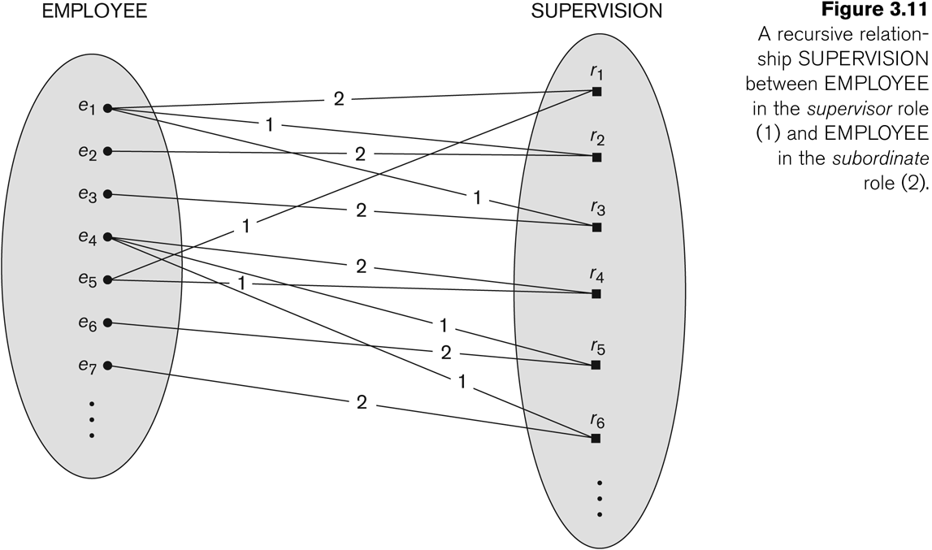
A Recursive Relationship Supervision

Slide 38
Recursive Relationship Type is: SUPERVISION
(participation role names are shown)

Slide 39
Weak Entity Types
An entity that does not have a key attribute and that is identification-dependent on another entity type.
A weak entity must participate in an identifying relationship type with an owner or identifying entity type
Entities are identified by the combination of:
  A partial key of the weak entity type
  The particular entity they are related to in the identifying relationship type
Example:
  A DEPENDENT entity is identified by the dependent’s first name, and the specific EMPLOYEE with whom the dependent is related
  Name of DEPENDENT is the partial key
  DEPENDENT is a weak entity type
  EMPLOYEE is its identifying entity type via the identifying relationship type DEPENDENT_OF

Slide 40
Attributes of Relationship types
A relationship type can have attributes:
  For example, HoursPerWeek of WORKS_ON
  Its value for each relationship instance describes the number of hours per week that an EMPLOYEE works on a PROJECT.
  A value of HoursPerWeek depends on a particular (employee, project) combination
  Most relationship attributes are used with M:N relationships
  In 1:N relationships, they can be transferred to the entity type on the N-side of the relationship

Slide 41
Example Attribute of a Relationship Type: Hours of WORKS_ON

Slide 42
Notation for Constraints on Relationships
Cardinality ratio (of a binary relationship): 1:1, 1:N, N:1, or M:N
  Shown by placing appropriate numbers on the relationship edges.
Participation constraint (on each participating entity type): total (called existence dependency) or partial.
  Total shown by double line, partial by single line.
NOTE: These are easy to specify for Binary Relationship Types.

Slide 43
Alternative (min, max) notation for relationship structural constraints:
Specified on each participation of an entity type E in a relationship type R
Specifies that each entity e in E participates in at least min and at most max relationship instances in R
Default(no constraint): min=0, max=n (signifying no limit)
Must have min <= max, min>=0, max >= 1
Derived from the knowledge of mini-world constraints
Examples:
  A department has exactly one manager and an employee can manage at most one department.
  Specify (0,1) for participation of EMPLOYEE in MANAGES
  Specify (1,1) for participation of DEPARTMENT in MANAGES
  An employee can work for exactly one department but a department can have any number of employees.
  Specify (1,1) for participation of EMPLOYEE in WORKS_FOR
  Specify (0,n) for participation of DEPARTMENT in WORKS_FOR

Slide 44
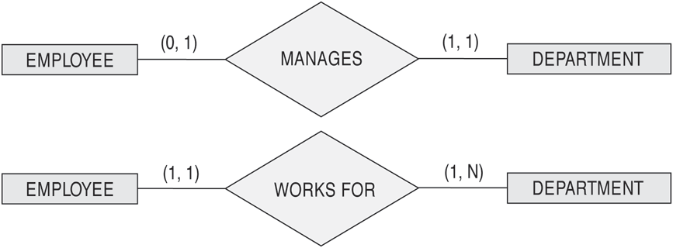
The (min,max) notation for relationship constraints
Read the min,max numbers next to the entity type and looking away from the entity type

Slide 45
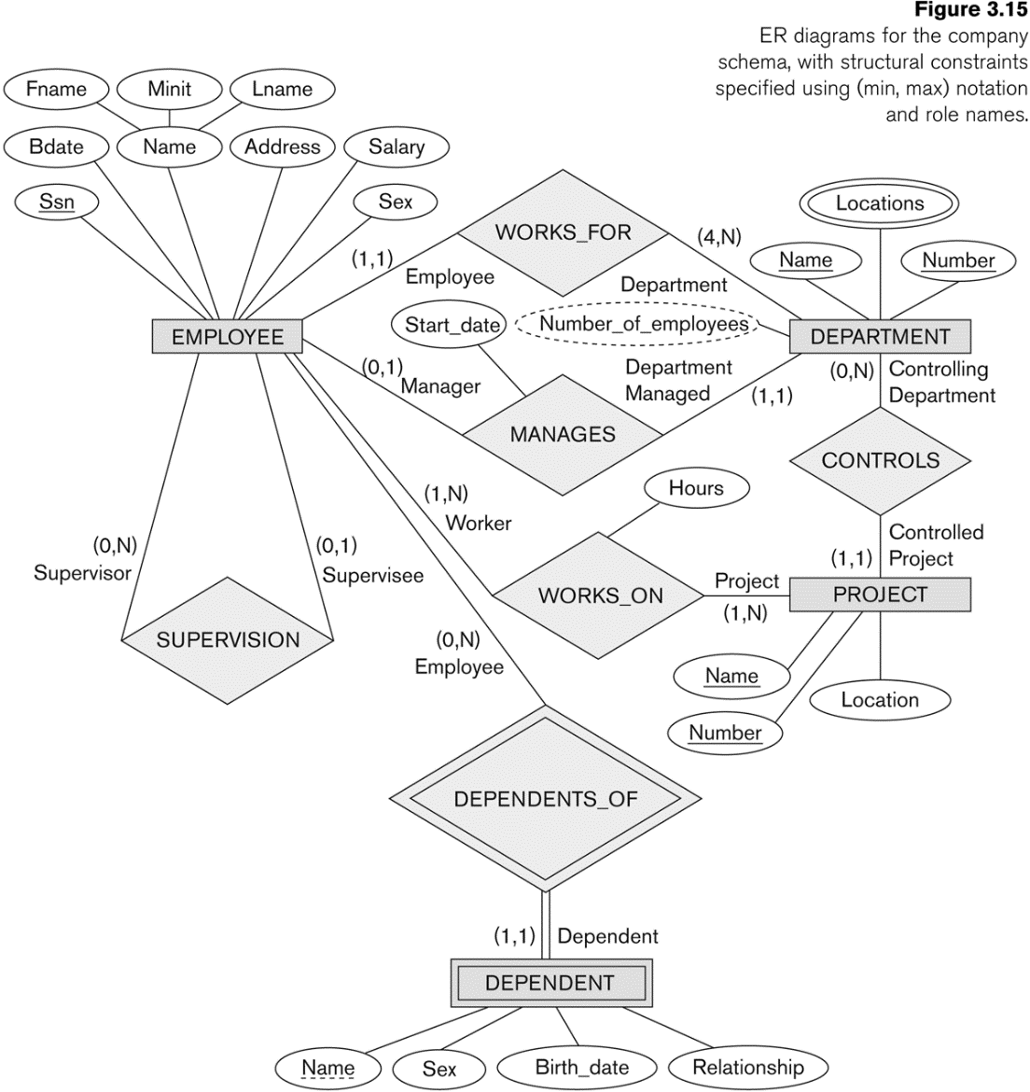
COMPANY ER Schema Diagram using (min, max) notation

Slide 46
Alternative diagrammatic notation
ER diagrams is one popular example for displaying database schemas
Many other notations exist in the literature and in various database design and modeling tools
UML class diagrams is representative of another way of displaying ER concepts that is used in several commercial design tools

Slide 47
Relationships of Higher Degree
Relationship types of degree 2 are called binary
Relationship types of degree 3 are called ternary and of degree n are called n-ary
In general, an n-ary relationship is not equivalent to n binary relationships
Constraints are harder to specify for higher-degree relationships (n > 2) than for binary relationships

Slide 48
Summary of notation for ER diagrams

Slide 49
Discussion of n-ary relationships (n > 2)
In general, 3 binary relationships can represent different information than a single ternary relationship
If needed, the binary and n-ary relationships can all be included in the schema design (
In some cases, a ternary relationship can be represented as a weak entity if the data model allows a weak entity type to have multiple identifying relationships (and hence multiple owner entity types)

Slide 50
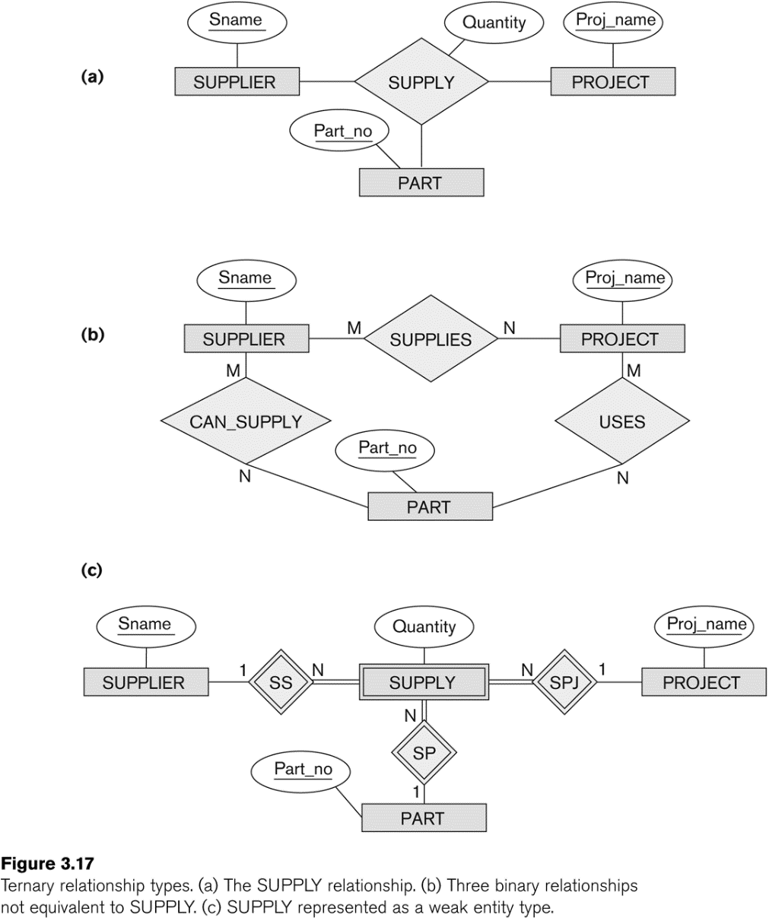
Example of a ternary relationship

Slide 51
Discussion of n-ary relationships (n > 2)
If a particular binary relationship can be derived from a higher-degree relationship at all times, then it is redundant
For example, the TAUGHT_DURING binary relationship in Figure 3.18 (see next slide) can be derived from the ternary relationship OFFERS (based on the meaning of the relationships)

Slide 52
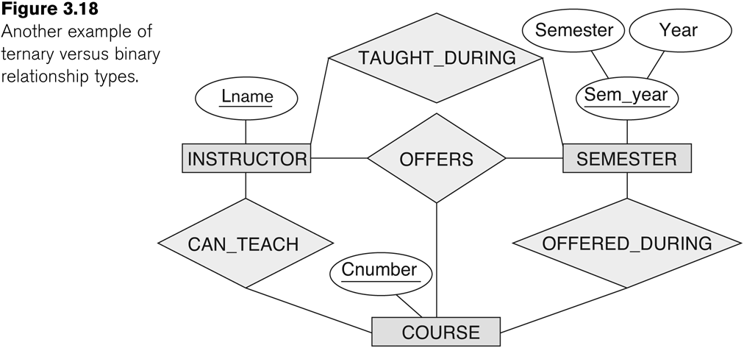
Another example of a ternary relationship

Slide 53
Displaying constraints on higher-degree relationships
The (min, max) constraints can be displayed on the edges – however, they do not fully describe the constraints
Displaying a 1, M, or N indicates additional constraints
An M or N indicates no constraint
A 1 indicates that an entity can participate in at most one relationship instance that has a particular combination of the other participating entities
In general, both (min, max) and 1, M, or N are needed to describe fully the constraints
Overall, the constraint specification is difficult and possibly ambiguous when we consider relationships of a degree higher than two.

Slide 54
Another Example: A UNIVERSITY Database
To keep track of the enrollments in classes and student grades, another database is to be designed.
It keeps track of the COLLEGEs, DEPARTMENTs within each college, the COURSEs offered by departments, and SECTIONs of courses, INSTRUCTORs who teach the sections etc.
These entity types and the relationships among these entity types are shown on the next slide in Figure 3.20.

Slide 55
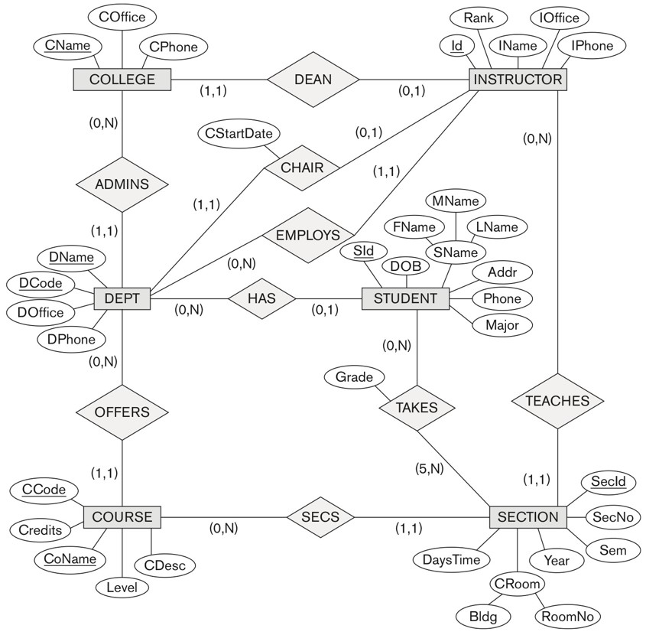
UNIVERSITY database conceptual schema

Slide 56
Data Modeling Tools (Additional Material )
A number of popular tools that cover conceptual modeling and mapping into relational schema design.
Examples: ERWin, S- Designer (Enterprise Application Suite), ER- Studio, etc.
POSITIVES:
  Serves as documentation of application requirements, easy user interface - mostly graphics editor support
NEGATIVES:
  Most tools lack a proper distinct notation for relationships with relationship attributes
  Mostly represent a relational design in a diagrammatic form rather than a conceptual ER-based design

Slide 57
Chapter Summary
ER Model Concepts: Entities, attributes, relationships
Constraints in the ER model
Using ER in step-by-step mode conceptual schema design for the COMPANY database
ER Diagrams - Notation
Binary Relationship types and those of higher degree.

