Slide 1
Chapter 1
Databases and Database Users

Slide 2
Outline
Types of Databases and Database Applications
Basic Definitions
Typical DBMS Functionality
Example of a Database (UNIVERSITY)
Main Characteristics of the Database Approach
Types of Database Users
Advantages of Using the Database Approach

Slide 3
What is a database
A database is a collection of related data.
Data refers to known facts that can be recorded and have an implicit meaning.
Examples of data include; names, telephone numbers, social security numbers, emplids, and addresses of the people you may know.

Slide 4
Types of Databases and Database Applications
Traditional Database Applications
Information that is stored and accessed is either textual or numeric
Examples include CUNYfirst, Amazon, and hotel or airline reservation
More Recent Database Applications:
Multimedia Databases
Geographic Information Systems (GIS)
Biological and Genome Databases
Data Warehouses
Mobile databases
Real-time and Active Databases
In this course, we will only focus on traditional applications

Slide 5
Recent Developments (1)
Social Networks captures a lot of information about people and about communications among people-posts, tweets, photos, videos in systems such as:
Facebook
Twitter
Linked-In
Instagram
YouTube
All of the above constitutes data

Slide 6
Recent Developments (2)
Search Engines such Google, Bing, and Yahoo; collect their own repository of web pages for searching purposes

Slide 7
Recent Developments (3)
New Technologies are emerging from the so-called non-database software vendors to manage vast amounts of data generated on the web:
Big Data storage systems involving large clusters of distributed computers
NOSQL (Not Only SQL) systems
A large amount of data now resides on the “cloud” which means it is in huge data centers using thousands of machines.

Slide 8
Introductions and Basic Definitions (1)
Database is a collection of related data.
Mini-world:
A database represents some aspect of the real world often called the miniworld or the universe of discourse (UoD).
For example, student grades and transcripts at a university.
Databases vary in size and complexity
Database may be manual or computerized
A computerized database are created and maintained either by application programs or a database management system (DBMS).

Slide 9
Introductions and Basic Definitions (2)
Database Management System (DBMS) is a software package/ system used to facilitate the creation and maintenance of a computerized database.
Database System includes the DBMS software together with the data itself. Sometimes, the applications are also included.

Slide 10
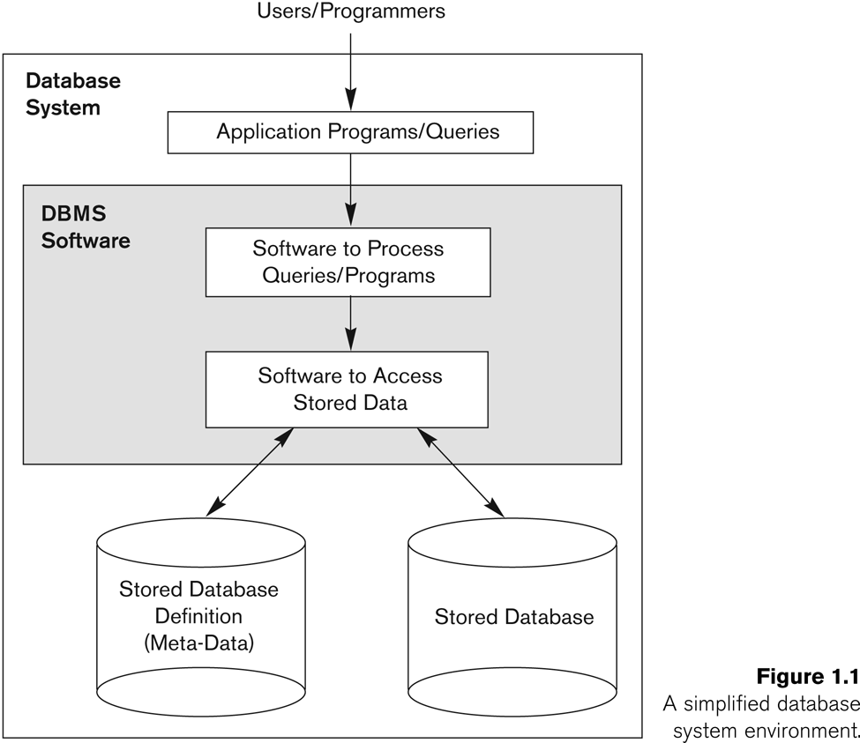
Simplified database system environment

Slide 11
Functions of Typical DBMS (1)
Defining a particular database by specifying its data types, structures, and constraints
This database definition or descriptive information is also stored by the DBMS in the form of a database catalog or dictionary; it is called meta-data.
Constructing or Loading the initial database contents on a secondary storage medium
Database Manipulation:
Retrieval: Querying, generating reports
Modification: Insertions, deletions and updates to its content
Accessing the database through Web applications
Processing and Sharing by a set of concurrent users and application programs – yet, keeping all data valid and consistent

Slide 12
Additional Functions of DBMS
Protection or Security measures to prevent unauthorized access
“Active” processing to take internal actions on data
Presentation and Visualization of data
Maintenance of the database and associated programs over the lifetime of the database application
Called database, software, and system maintenance

Slide 13
Activities of Applications Against a Database
Applications interact with a database by generating
Queries: that access different parts of data and formulate the result of a request
Transactions: that may read some data and “update” certain values or generate new data and store that in the database
Applications must not allow unauthorized users to access data
Applications must keep up with changing user requirements against the database

Slide 14
Example of a Database (with a Conceptual Data Model)
Mini-world for the example:
Part of a UNIVERSITY environment.
Some mini-world entities:
STUDENTs
COURSEs
SECTIONs (of COURSEs)
(academic) DEPARTMENTs
INSTRUCTORs

Slide 15
Example of a Database (with a Conceptual Data Model)
Some mini-world relationships:
SECTIONs are of specific COURSEs
STUDENTs take SECTIONs
COURSEs have prerequisite COURSEs
INSTRUCTORs teach SECTIONs
COURSEs are offered by DEPARTMENTs
STUDENTs major in DEPARTMENTs

Slide 16
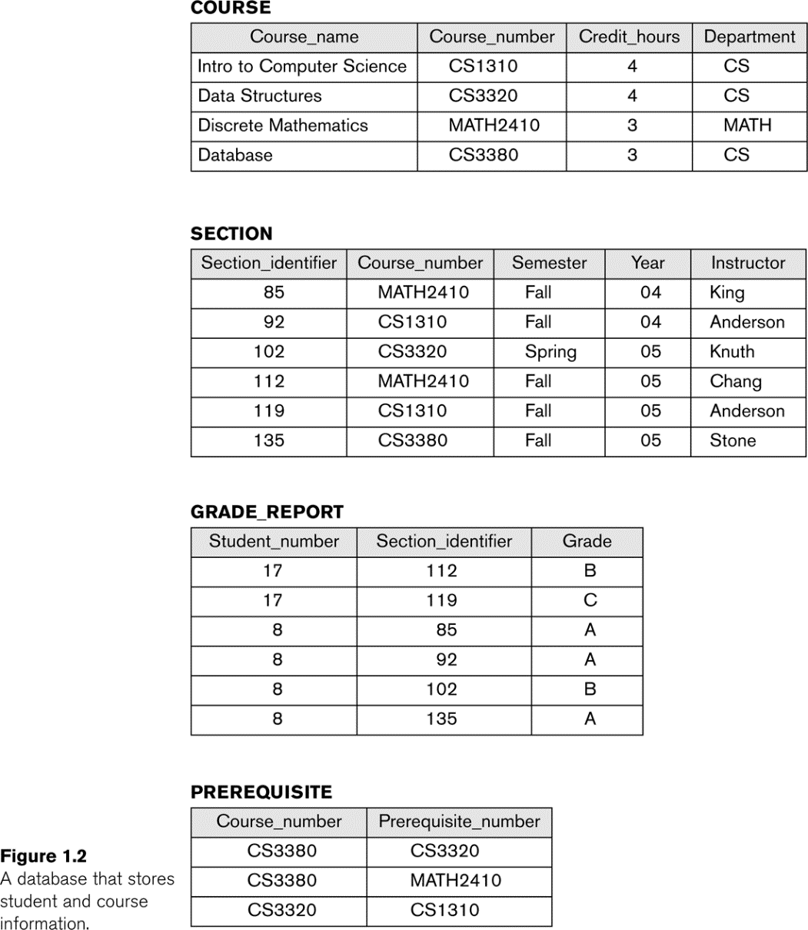
Example of a simple database

Slide 17
Characteristics of the Database Approach
Self-describing nature of a database system:
A DBMS catalog stores the description of a particular database (e.g. data structures, types, and constraints)
The description is called meta-data*.
This allows the DBMS software to work with different database applications.
Insulation between programs and data:
Called program-data independence.
Allows changing data structures and storage organization without having to change the DBMS access programs.

Slide 18
Characteristics of the Database Approach (Continued)
Data Abstraction:
A data model is used to hide storage details and present the users with a conceptual view of the database.
Programs refer to the data model constructs rather than data storage details
Support of multiple views of the data:
Each user may see a different view of the database, which describes only the data of interest to that user.

Slide 19
Characteristics of the Database Approach (Continued)
Sharing of data and multi-user transaction processing:
Allowing a set of concurrent users to retrieve from and to update the database.
Concurrency control within the DBMS guarantees that each transaction is correctly executed or aborted
Recovery subsystem ensures each completed transaction has its effect permanently recorded in the database
OLTP (Online Transaction Processing) is a major part of database applications. This allows hundreds of concurrent transactions to execute per second.

Slide 20
Database Users
Users may be divided into
Those who actually use and control the database content, and those who design, develop and maintain database applications (called “Actors on the Scene”), and
Those who design and develop the DBMS software and related tools, and the computer systems operators (called “Workers Behind the Scene”).

Slide 21
Database Users – Actors on the Scene
Database administrators:
Responsible for authorizing access to the database, for coordinating and monitoring its use, acquiring software and hardware resources, controlling its use and monitoring efficiency of operations.
Database Designers:
Responsible to define the content, the structure, the constraints, and functions or transactions against the database. They must communicate with the end-users and understand their needs.

Slide 22
Database Users – Actors on the Scene
End-users: They use the data for queries, reports and some of them update the database content. End-users can be categorized into:
Casual: access database occasionally when needed
Naïve or Parametric: they make up a large section of the end-user population.
They use previously well-defined functions in the form of “canned transactions” against the database.
Users of Mobile Apps mostly fall in this category
Bank-tellers or reservation clerks are parametric users who do this activity for an entire shift of operations.
Social Media Users post and read information from websites

Slide 23
Database Users – Actors on the Scene
Sophisticated:
These include business analysts, scientists, engineers, others thoroughly familiar with the system capabilities.
Many use tools in the form of software packages that work closely with the stored database.
Stand-alone:
Mostly maintain personal databases using ready-to-use packaged applications.
An example is the user of a tax program that creates its own internal database.
Another example is a user that maintains a database of personal photos and videos.

Slide 24
Database Users – Actors on the Scene
System Analysts and Application Developers - This category currently accounts for a very large proportion of the IT work force.
System Analysts: They understand the user requirements of naïve and sophisticated users and design applications including canned transactions to meet those requirements.
Application Programmers: Implement the specifications developed by analysts and test and debug them before deployment.
Business Analysts: There is an increasing need for such people who can analyze vast amounts of business data and real-time data (“Big Data”) for better decision making related to planning, advertising, marketing etc.

Slide 25
Database Users – Actors behind the Scene
System Designers and Implementors: Design and implement DBMS packages in the form of modules and interfaces and test and debug them. The DBMS must interface with applications, language compilers, operating system components, etc.
Tool Developers: Design and implement software systems called tools for modeling and designing databases, performance monitoring, prototyping, test data generation, user interface creation, simulation etc. that facilitate building of applications and allow using database effectively.
Operators and Maintenance Personnel: They manage the actual running and maintenance of the database system hardware and software environment.

Slide 26
Advantages of Using the Database Approach
Controlling redundancy in data storage and in development and maintenance efforts.
Sharing of data among multiple users.
Restricting unauthorized access to data. Only the DBA staff uses privileged commands and facilities.
Providing persistent storage for program Objects
E.g., Object-oriented DBMSs make program objects persistent
Providing Storage Structures (e.g. indexes) for efficient Query Processing

Slide 27
Advantages of Using the Database Approach (continued)
Providing optimization of queries for efficient processing.
Providing backup and recovery services.
Providing multiple interfaces to different classes of users.
Representing complex relationships among data.
Enforcing integrity constraints on the database.
Drawing inferences and actions from the stored data using deductive and active rules and triggers.

Slide 28
Additional Implications of Using the Database Approach
Potential for enforcing standards:
This is very crucial for the success of database applications in large organizations. Standards refer to data item names, display formats, screens, report structures, meta-data (description of data), Web page layouts, etc.
Reduced application development time:
Incremental time to add each new application is reduced.
Flexibility to change data structures:
Database structure may evolve as new requirements are defined.
Availability of current information:
Extremely important for on-line transaction systems such as shopping, airline, hotel, car reservations.

Slide 29
Additional Implications of Using the Database Approach (Continued)
Economies of scale:
Wasteful overlap of resources and personnel can be avoided by consolidating data and applications across departments.

Slide 30
Chapter Summary
Types of Databases and Database Applications
Basic Definitions
Typical DBMS Functionality
Example of a Database (UNIVERSITY)
Main Characteristics of the Database Approach
Types of Database Users
Advantages of Using the Database Approach

