Slide 1
Chapter 4: Threads & Concurrency

Slide 2
Outline
Overview
Multicore Programming
Multithreading Models
Thread Libraries
Implicit Threading
Threading Issues
Operating System Examples

Slide 3
Objectives
Identify the basic components of a thread, and contrast threads and processes
Describe the benefits and challenges of designng multithreaded applications
Illustrate different approaches to implicit threading including thread pools, fork-join, and Grand Central Dispatch
Describe how the Windows and Linux operating systems represent threads
Design multithreaded applications using the Pthreads, Java, and Windows threading APIs

Slide 4
Motivation
Most modern applications are multithreaded
Threads run within application
Multiple tasks with the application can be implemented by separate threads
  Update display
  Fetch data
  Spell checking
  Answer a network request
Process creation is heavy-weight while thread creation is light-weight
Can simplify code, increase efficiency
Kernels are generally multithreaded

Slide 5
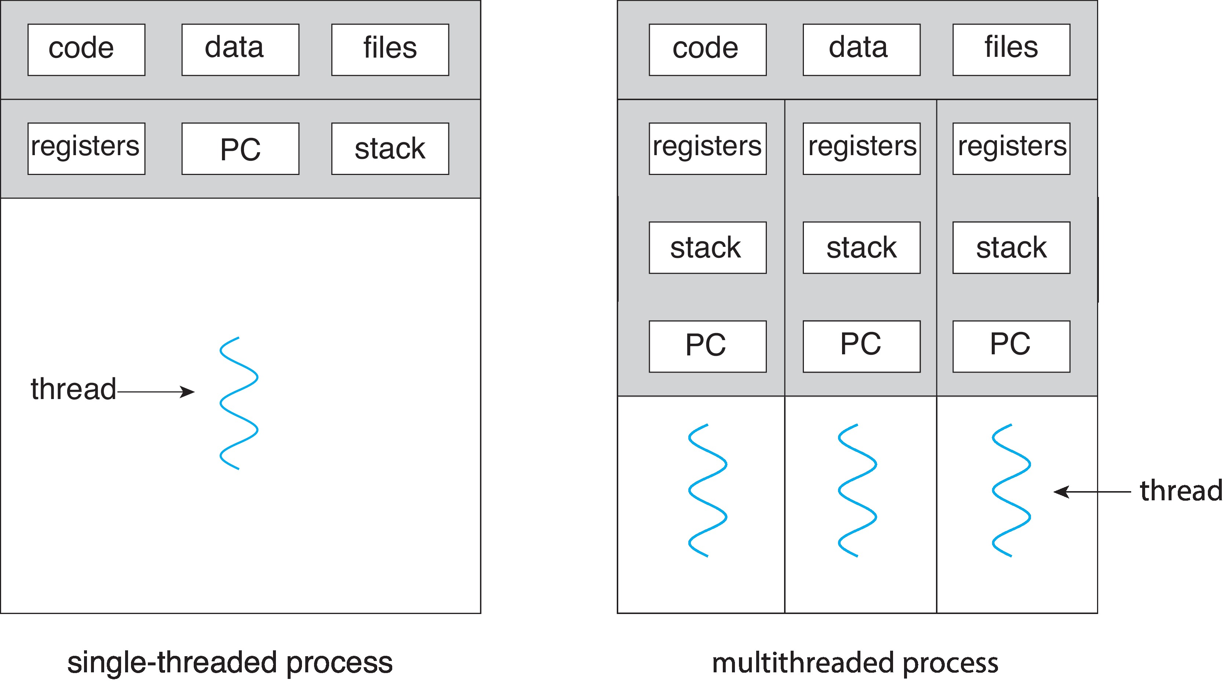
Single and Multithreaded Processes

Slide 6
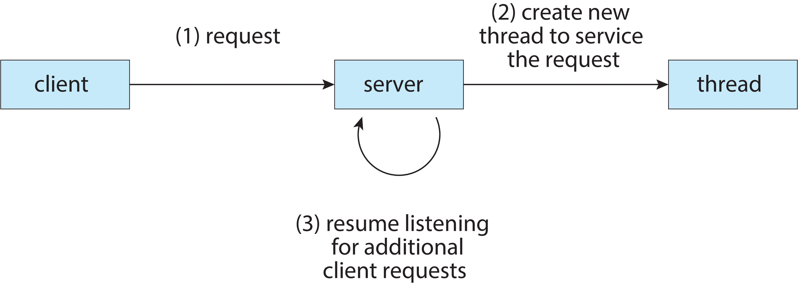
Multithreaded Server Architecture

Slide 7
Benefits
Responsiveness – may allow continued execution if part of process is blocked, especially important for user interfaces
Resource Sharing – threads share resources of process, easier than shared memory or message passing
Economy – cheaper than process creation, thread switching lower overhead than context switching
Scalability – process can take advantage of multicore architectures

Slide 8
Multicore Programming
Multicore or multiprocessor systems putting pressure on programmers, challenges include:
  Dividing activities
  Balance
  Data splitting
  Data dependency
  Testing and debugging
Parallelism implies a system can perform more than one task simultaneously
Concurrency supports more than one task making progress
  Single processor / core, scheduler providing concurrency

Slide 9
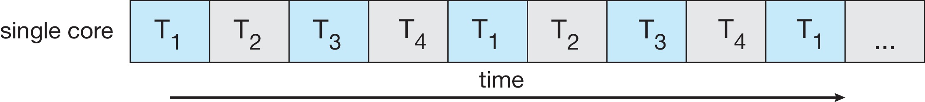
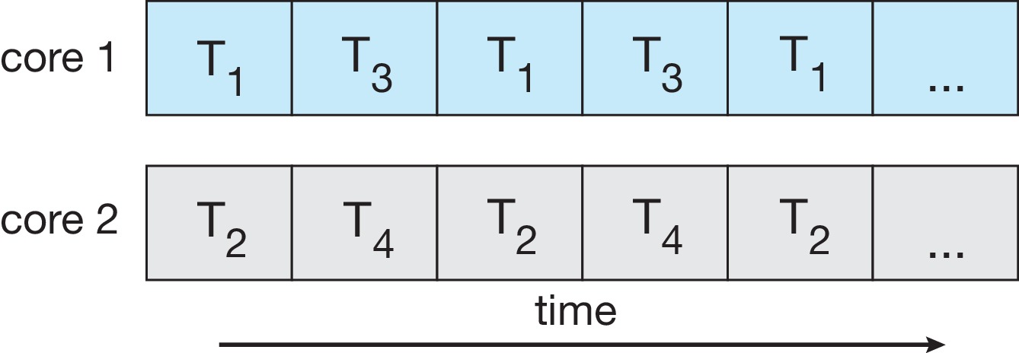
Concurrency vs. Parallelism
Concurrent execution on single-core system:
Parallelism on a multi-core system:

Slide 10
Multicore Programming
Types of parallelism
  Data parallelism – distributes subsets of the same data across multiple cores, same operation on each
  Task parallelism – distributing threads across cores, each thread performing unique operation

Slide 11
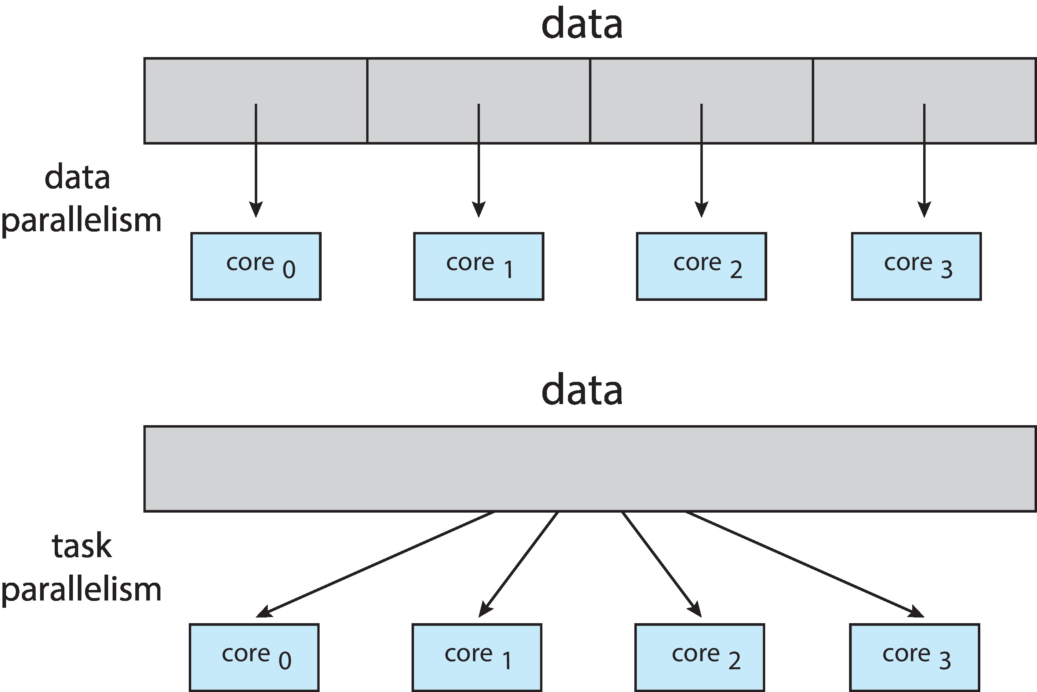
Data and Task Parallelism

Slide 12
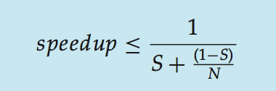
Amdahl’s Law
Identifies performance gains from adding additional cores to an application that has both serial and parallel components
S is serial portion
N processing cores
That is, if application is 75% parallel / 25% serial, moving from 1 to 2 cores results in speedup of 1.6 times
As N approaches infinity, speedup approaches 1 / S
Serial portion of an application has disproportionate effect on performance gained by adding additional cores
But does the law take into account contemporary multicore systems?

Slide 13
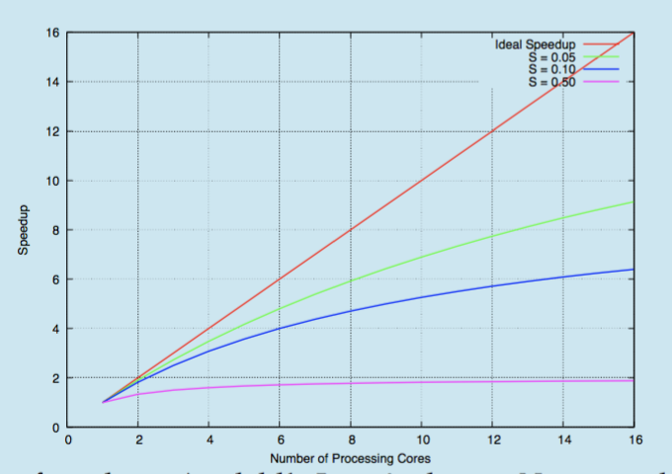
Amdahl’s Law

Slide 14
User Threads and Kernel Threads
User threads - management done by user-level threads library
Three primary thread libraries:
  POSIX Pthreads
  Windows threads
  Java threads
Kernel threads - Supported by the Kernel
Examples – virtually all general -purpose operating systems, including:
  Windows
  Linux
  Mac OS X
  iOS
  Android

Slide 15
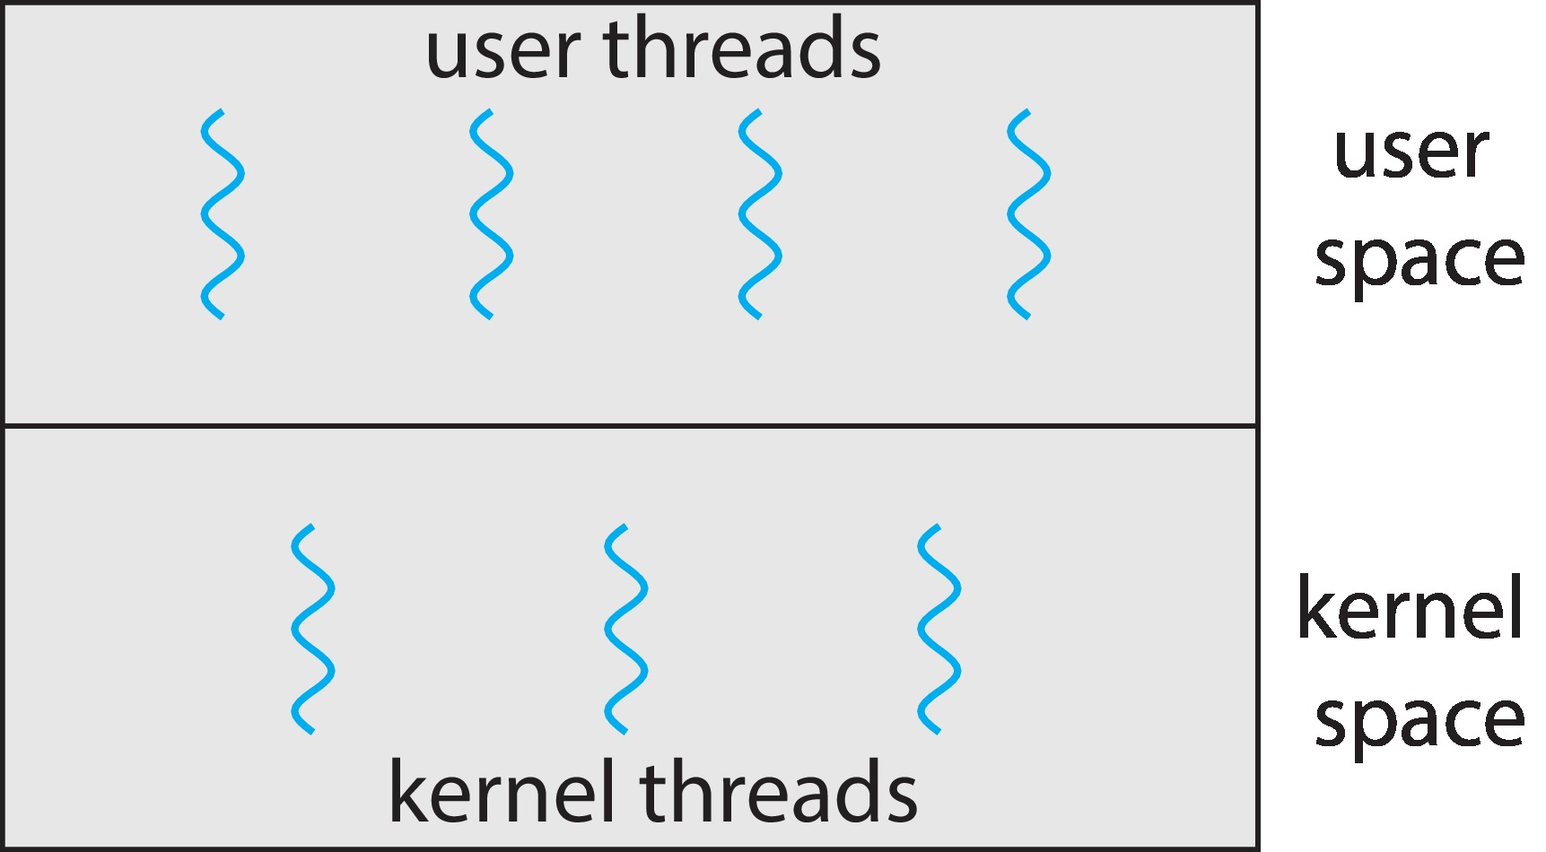
User and Kernel Threads

Slide 16
Multithreading Models
Many-to-One
One-to-One
Many-to-Many

Slide 17
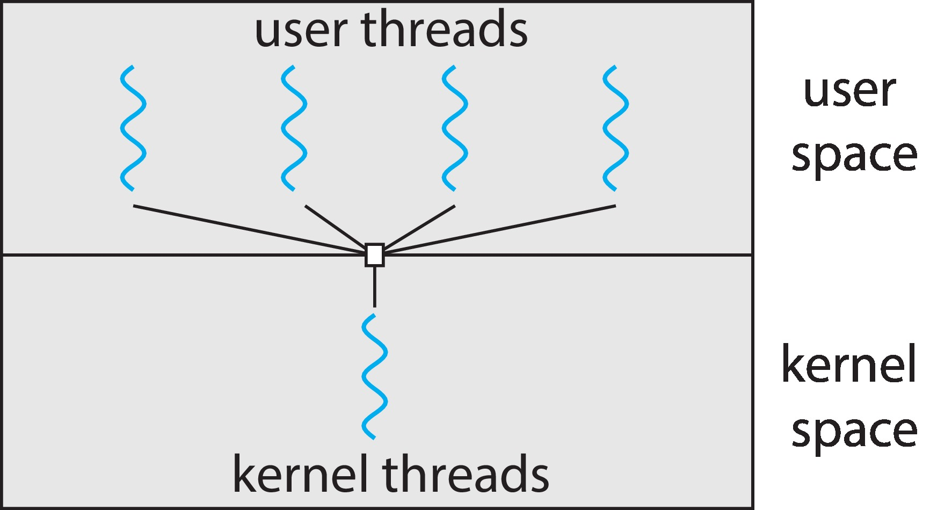
Many-to-One
Many user-level threads mapped to single kernel thread
One thread blocking causes all to block
Multiple threads may not run in parallel on muticore system because only one may be in kernel at a time
Few systems currently use this model
Examples:
  Solaris Green Threads
  GNU Portable Threads

Slide 18
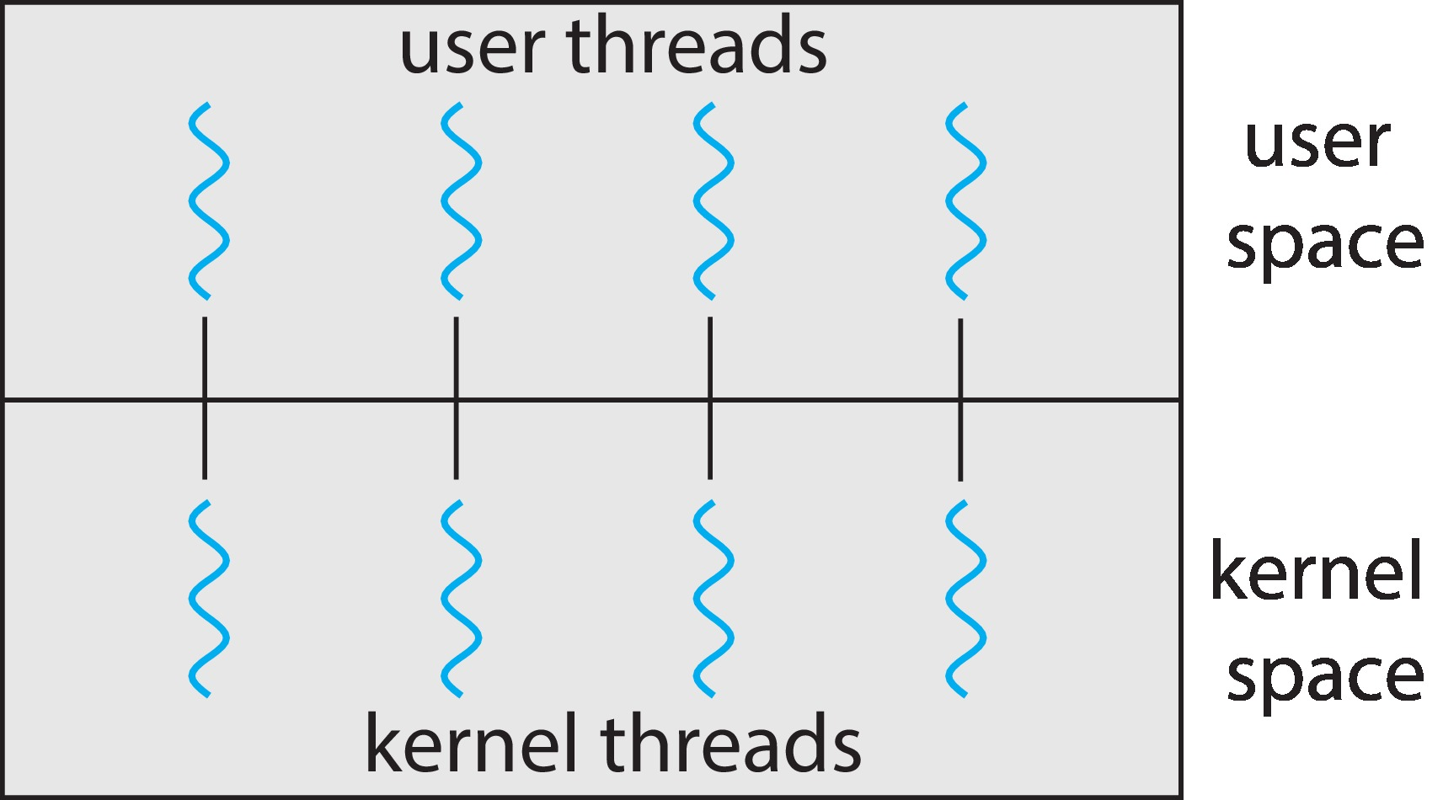
One-to-One
Each user-level thread maps to kernel thread
Creating a user-level thread creates a kernel thread
More concurrency than many-to-one
Number of threads per process sometimes restricted due to overhead
Examples
  Windows
  Linux

Slide 19
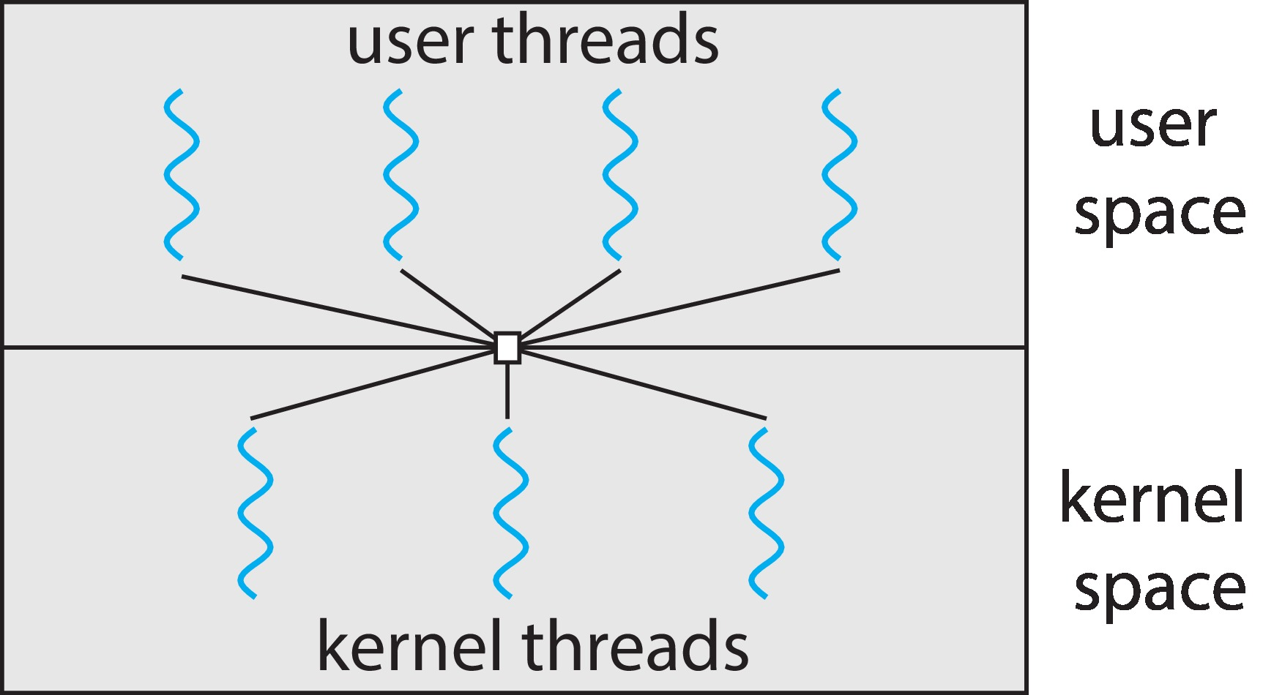
Many-to-Many Model
Allows many user level threads to be mapped to many kernel threads
Allows the operating system to create a sufficient number of kernel threads
Windows with the ThreadFiber package
Otherwise not very common

Slide 20
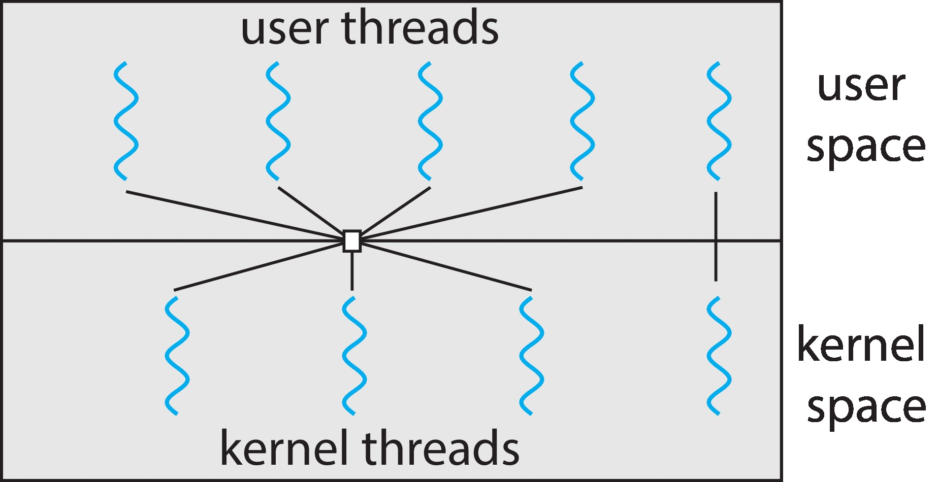
Two-level Model
Similar to M:M, except that it allows a user thread to be bound to kernel thread

Slide 21
Thread Libraries
Thread library provides programmer with API for creating and managing threads
Two primary ways of implementing
  Library entirely in user space
  Kernel-level library supported by the OS

Slide 22
Pthreads
May be provided either as user-level or kernel-level
A POSIX standard (IEEE 1003.1c) API for thread creation and synchronization
Specification, not implementation
API specifies behavior of the thread library, implementation is up to development of the library
Common in UNIX operating systems (Linux & Mac OS X)

Slide 23
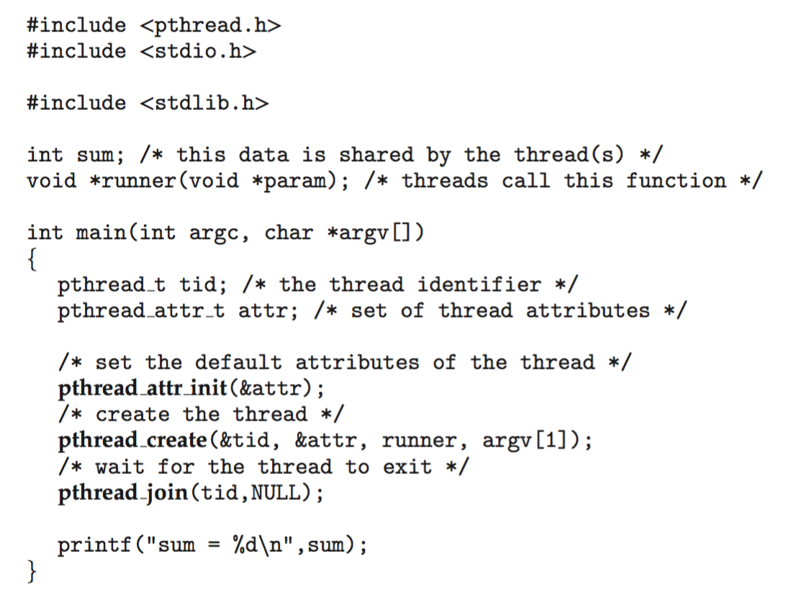
Pthreads Example

Slide 24
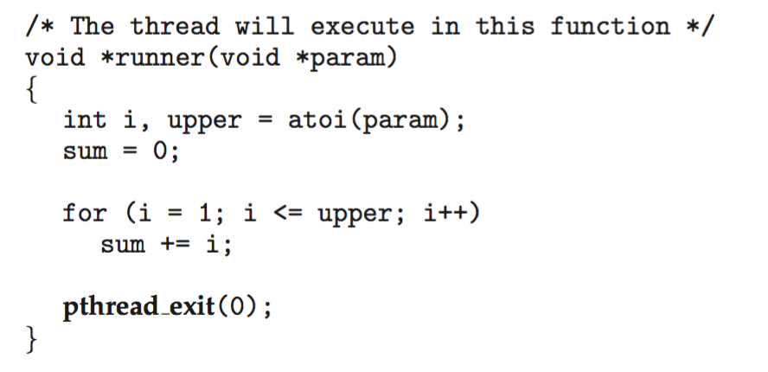
Pthreads Example (Cont.)

Slide 25
Pthreads Code for Joining 10 Threads

Slide 26
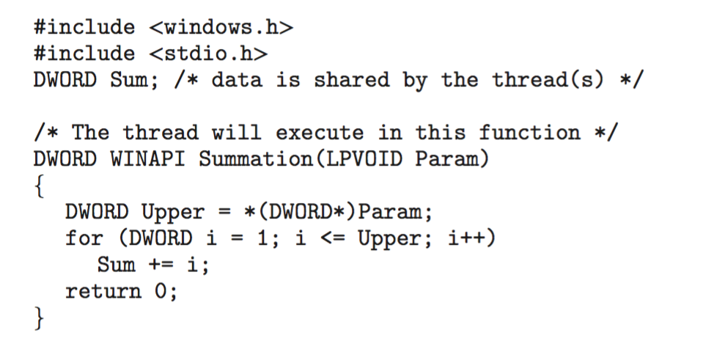
Windows Multithreaded C Program

Slide 27
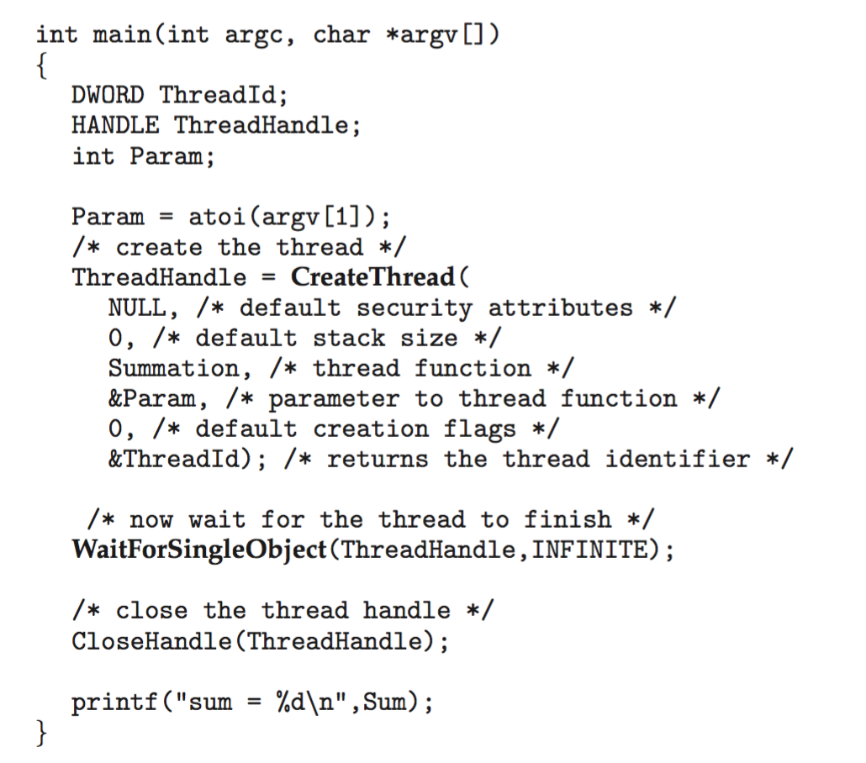
Windows Multithreaded C Program (Cont.)

Slide 28
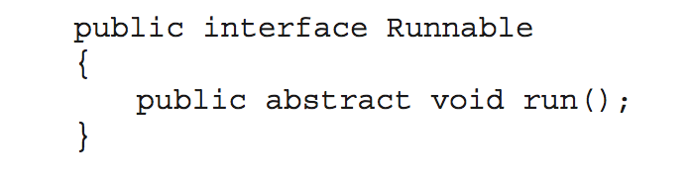
Java Threads
Java threads are managed by the JVM
Typically implemented using the threads model provided by underlying OS
Java threads may be created by:
  Extending Thread class
  Implementing the Runnable interface
  Standard practice is to implement Runnable interface

Slide 29
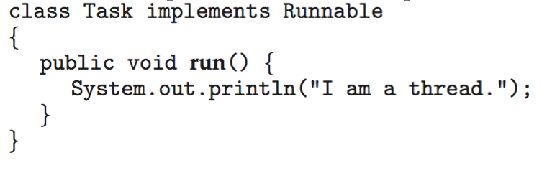
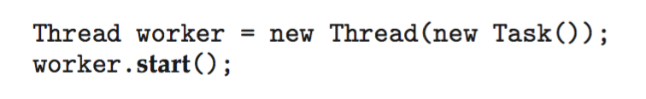
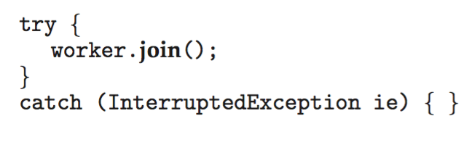
Java Threads
Implementing Runnable interface:
Creating a thread:
Waiting on a thread:

Slide 30
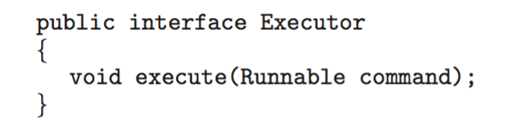
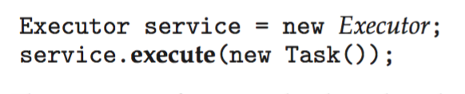
Java Executor Framework
Rather than explicitly creating threads, Java also allows thread creation around the Executor interface:
The Executor is used as follows:

Slide 31
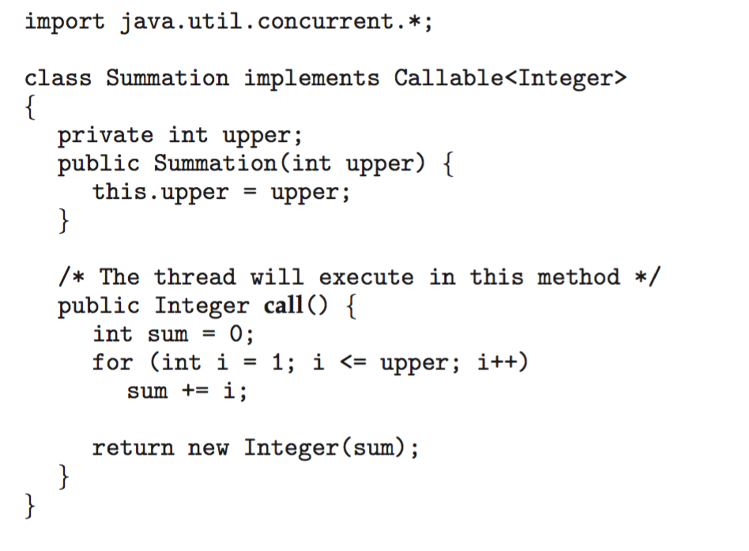
Java Executor Framework

Slide 32
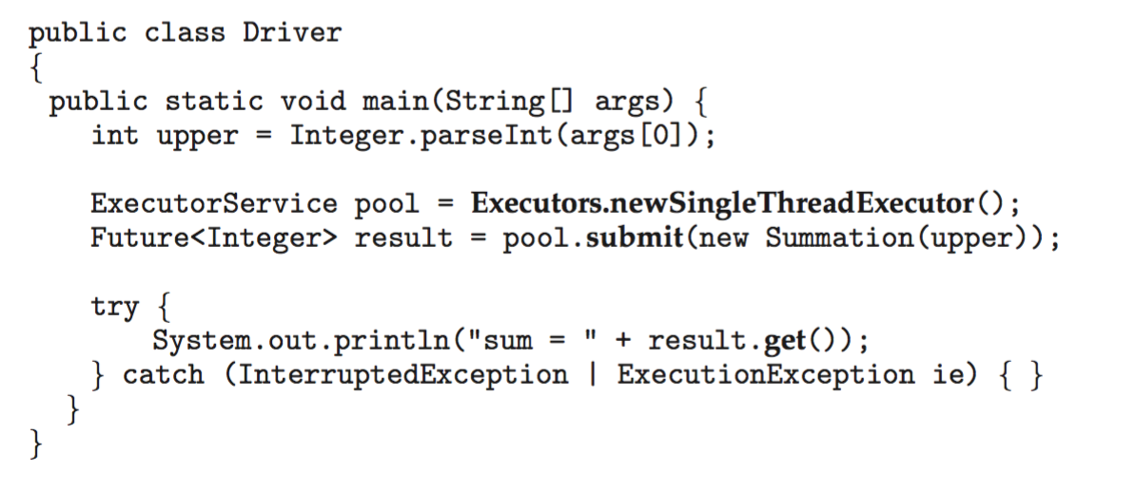
Java Executor Framework (Cont.)

Slide 33
Implicit Threading
Growing in popularity as numbers of threads increase, program correctness more difficult with explicit threads
Creation and management of threads done by compilers and run-time libraries rather than programmers
Five methods explored
  Thread Pools
  Fork-Join
  OpenMP
  Grand Central Dispatch
  Intel Threading Building Blocks

Slide 34
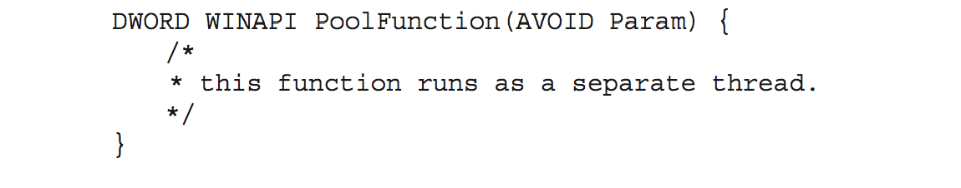
Thread Pools
Create a number of threads in a pool where they await work
Advantages:
  Usually slightly faster to service a request with an existing thread than create a new thread
  Allows the number of threads in the application(s) to be bound to the size of the pool
  Separating task to be performed from mechanics of creating task allows different strategies for running task
    i.e.,Tasks could be scheduled to run periodically
Windows API supports thread pools:

Slide 35
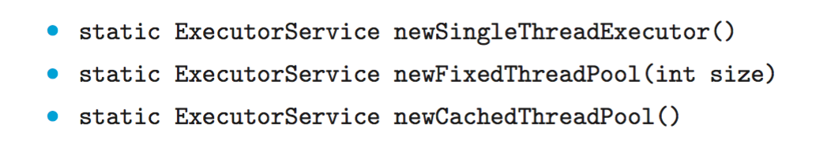
Java Thread Pools
Three factory methods for creating thread pools in Executors class:

Slide 36
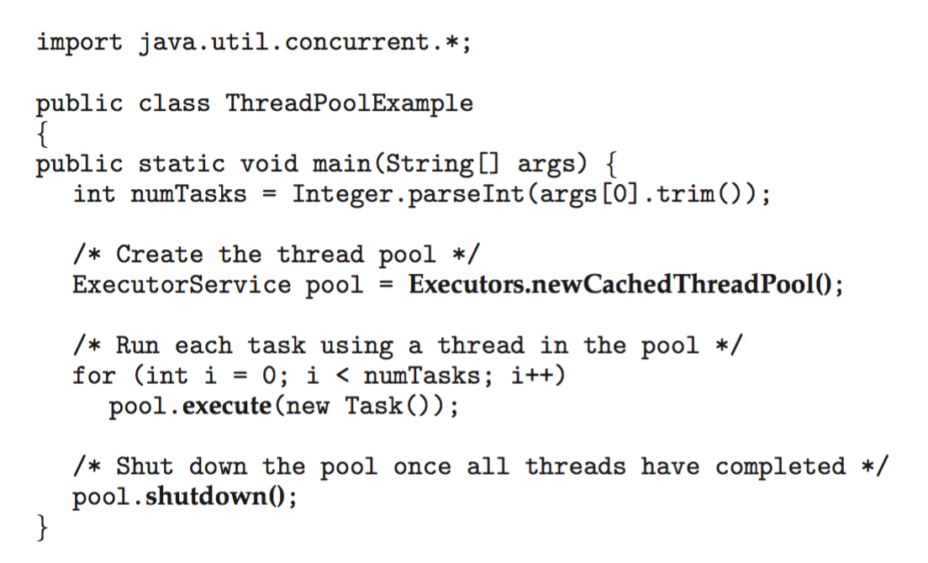
Java Thread Pools (Cont.)

Slide 37
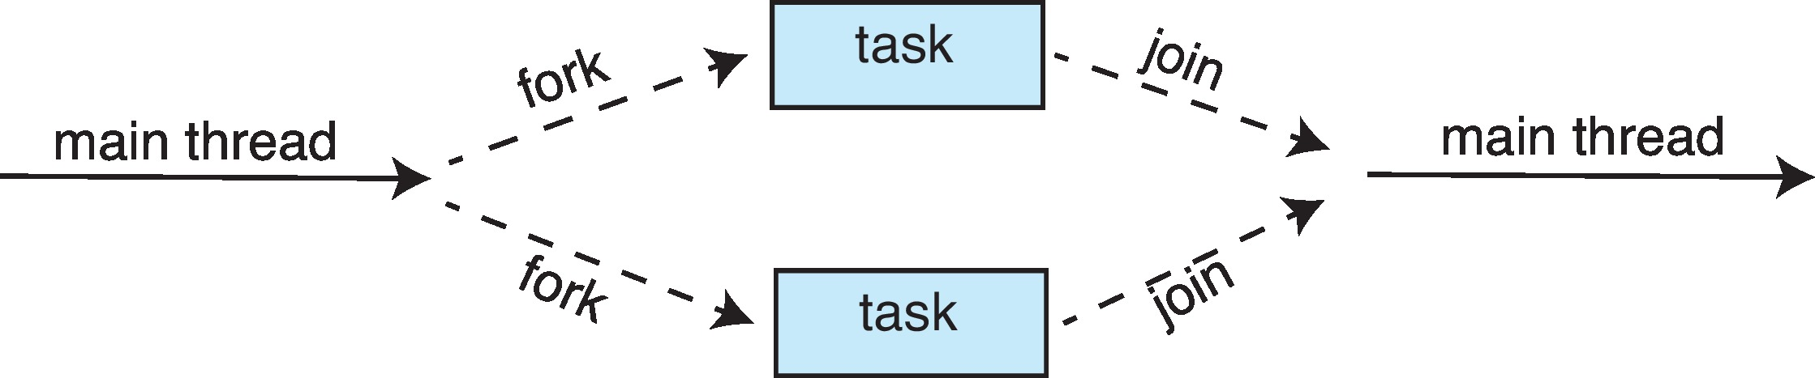
Fork-Join Parallelism
Multiple threads (tasks) are forked, and then joined.

Slide 38
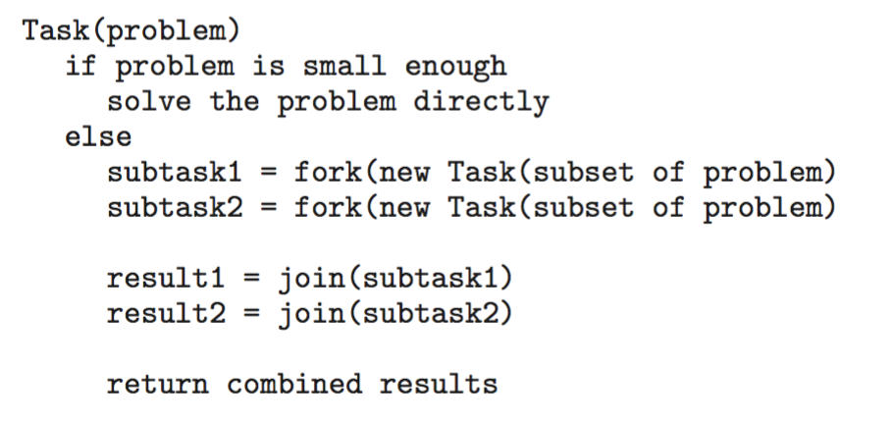
Fork-Join Parallelism
General algorithm for fork-join strategy:

Slide 39
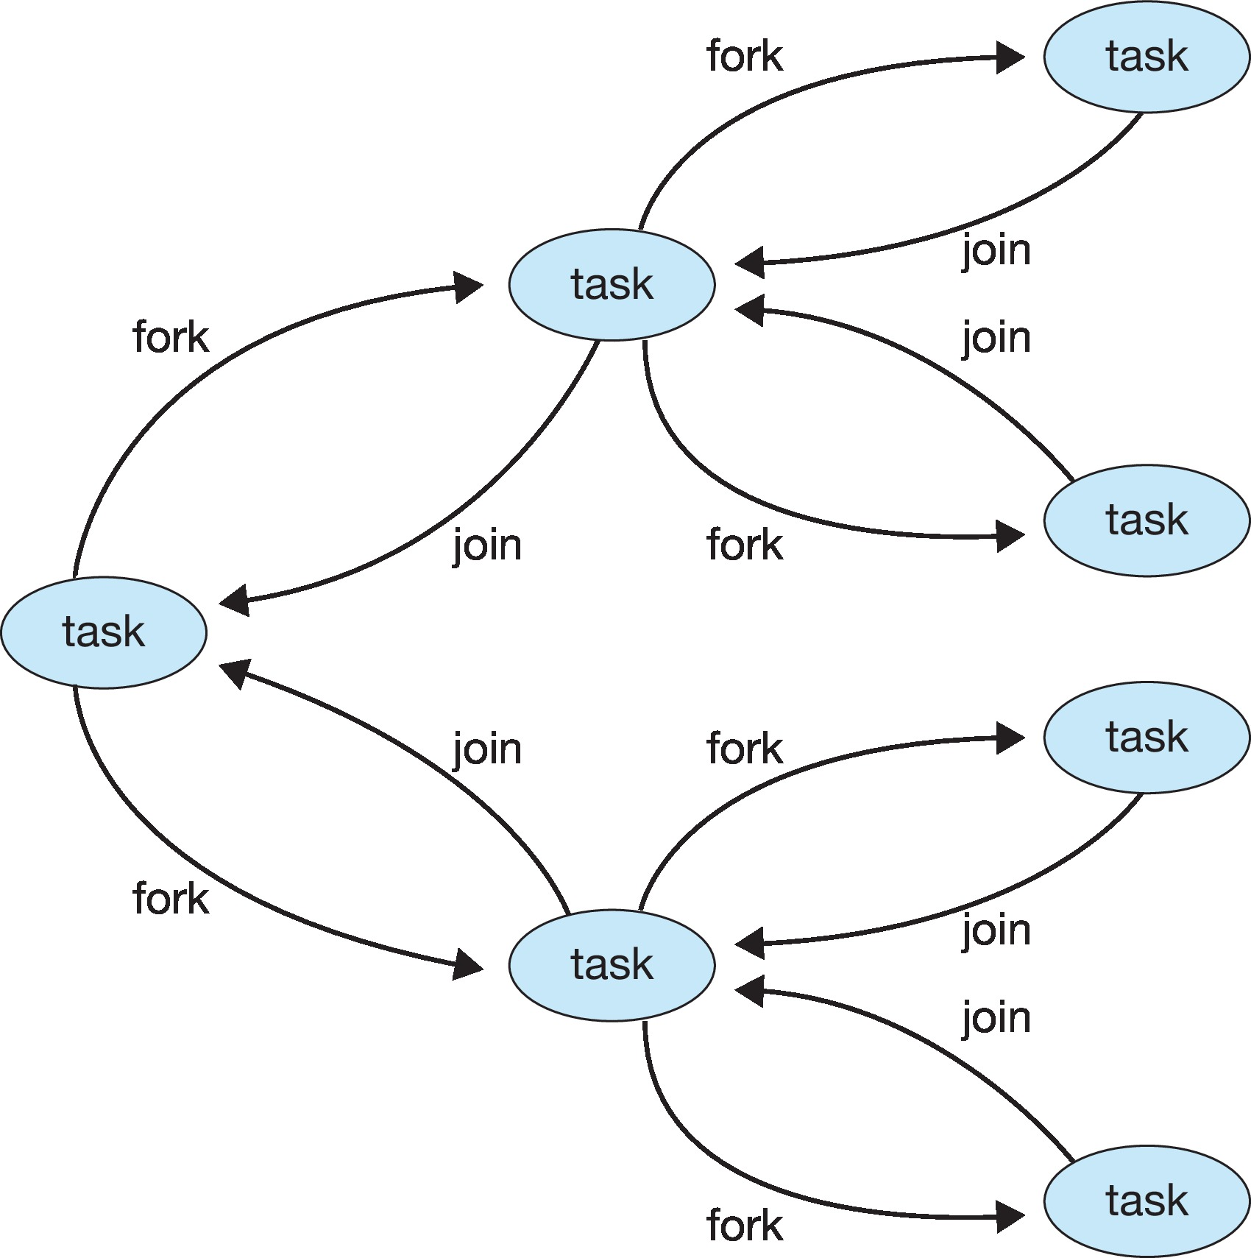
Fork-Join Parallelism

Slide 40
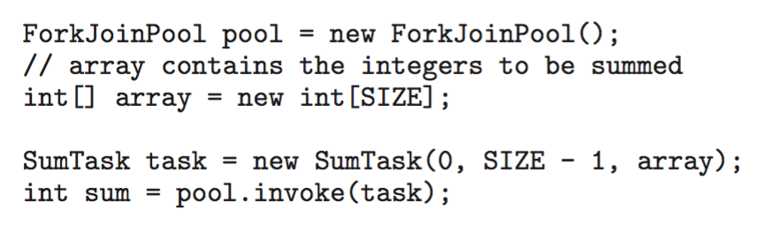
Fork-Join Parallelism in Java

Slide 41
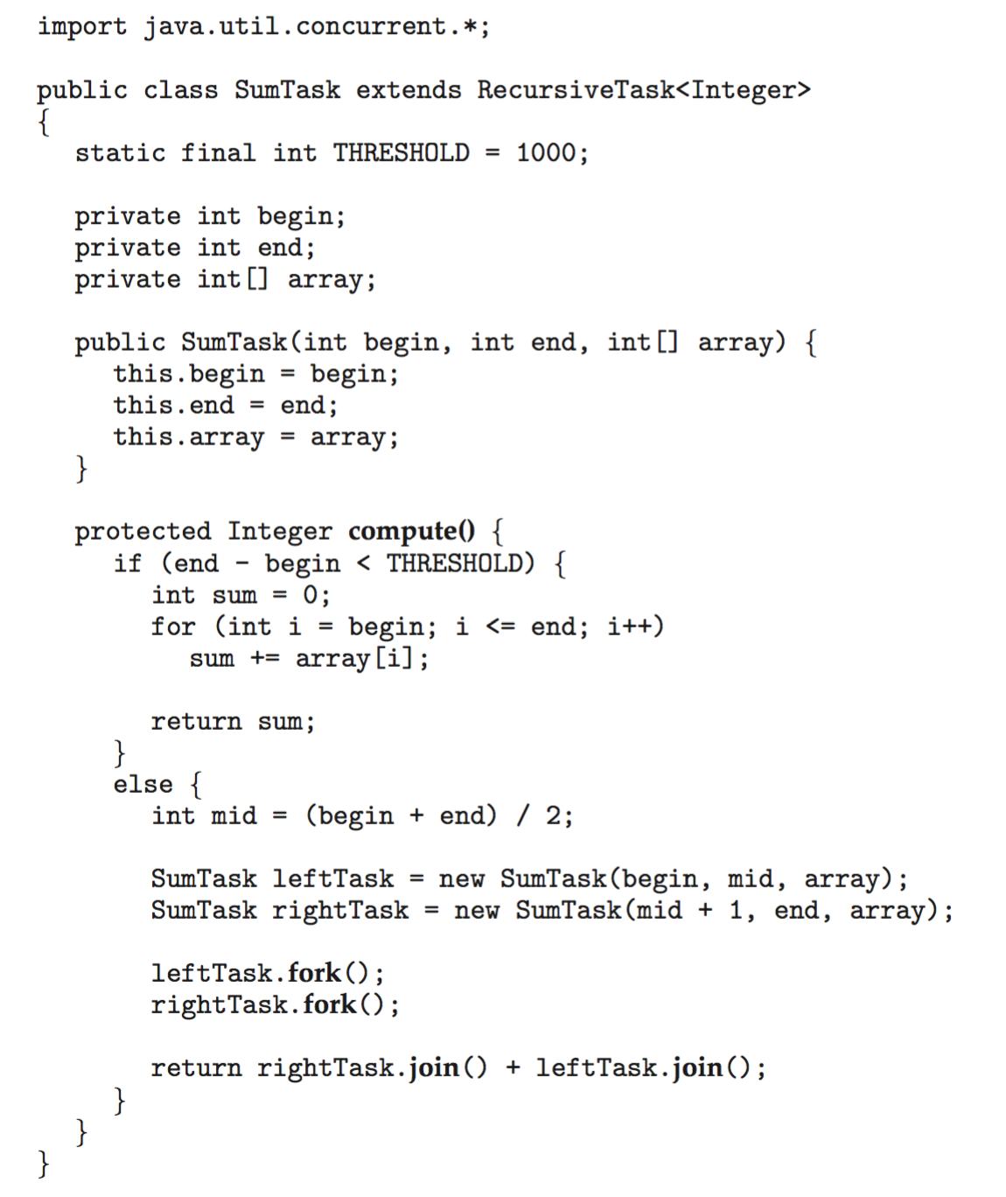
Fork-Join Parallelism in Java

Slide 42
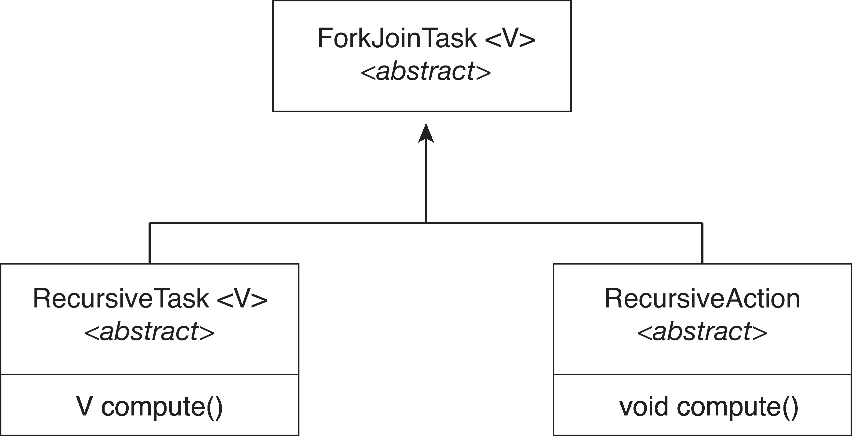
Fork-Join Parallelism in Java
The ForkJoinTask is an abstract base class
RecursiveTask and RecursiveAction classes extend ForkJoinTask
RecursiveTask returns a result (via the return value from the compute() method)
RecursiveAction does not return a result

Slide 43
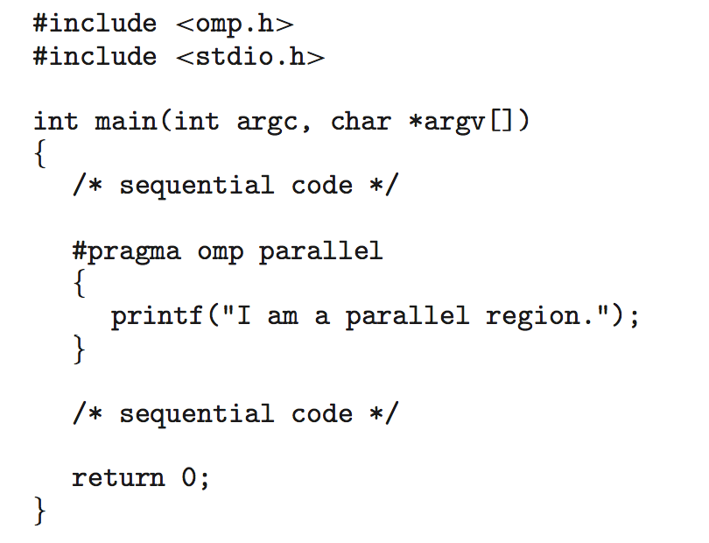
OpenMP
Set of compiler directives and an API for C, C++, FORTRAN
Provides support for parallel programming in shared-memory environments
Identifies parallel regions – blocks of code that can run in parallel
#pragma omp parallel
Create as many threads as there are cores

Slide 44
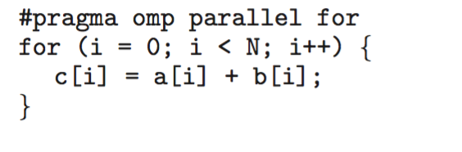
Run the for loop in parallel

Slide 45
Grand Central Dispatch
Apple technology for macOS and iOS operating systems
Extensions to C, C++ and Objective-C languages, API, and run-time library
Allows identification of parallel sections
Manages most of the details of threading
Block is in “^{ }” :
ˆ{ printf("I am a block"); }
Blocks placed in dispatch queue
  Assigned to available thread in thread pool when removed from queue

Slide 46
Grand Central Dispatch
Two types of dispatch queues:
  serial – blocks removed in FIFO order, queue is per process, called main queue
    Programmers can create additional serial queues within program
  concurrent – removed in FIFO order but several may be removed at a time
    Four system wide queues divided by quality of service:
    QOS_CLASS_USER_INTERACTIVE
    QOS_CLASS_USER_INITIATED
    QOS_CLASS_USER_UTILITY
    QOS_CLASS_USER_BACKGROUND

Slide 47
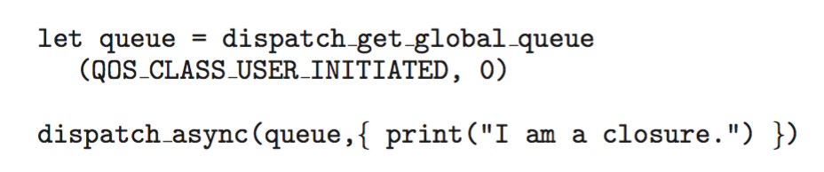
Grand Central Dispatch
For the Swift language a task is defined as a closure – similar to a block, minus the caret
Closures are submitted to the queue using the dispatch_async() function:

Slide 48
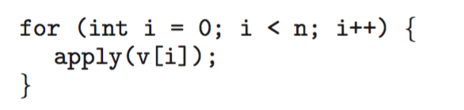
Intel Threading Building Blocks (TBB)
Template library for designing parallel C++ programs
A serial version of a simple for loop
The same for loop written using TBB with parallel_for statement:

Slide 49
Threading Issues
Semantics of fork() and exec() system calls
Signal handling
  Synchronous and asynchronous
Thread cancellation of target thread
  Asynchronous or deferred
Thread-local storage
Scheduler Activations

Slide 50
Semantics of fork() and exec()
Does fork()duplicate only the calling thread or all threads?
  Some UNIXes have two versions of fork
exec() usually works as normal – replace the running process including all threads

Slide 51
Signal Handling
Signals are used in UNIX systems to notify a process that a particular event has occurred.
A signal handler is used to process signals
  Signal is generated by particular event
  Signal is delivered to a process
  Signal is handled by one of two signal handlers:
    default
    user-defined
Every signal has default handler that kernel runs when handling signal
  User-defined signal handler can override default
  For single-threaded, signal delivered to process

Slide 52
Signal Handling (Cont.)
Where should a signal be delivered for multi-threaded?
  Deliver the signal to the thread to which the signal applies
  Deliver the signal to every thread in the process
  Deliver the signal to certain threads in the process
  Assign a specific thread to receive all signals for the process

Slide 53
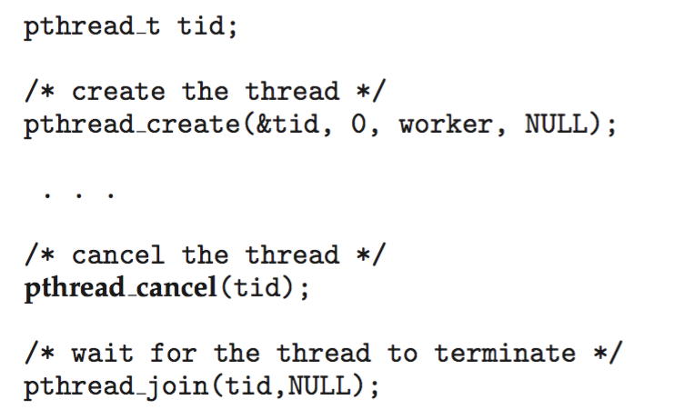
Thread Cancellation
Terminating a thread before it has finished
Thread to be canceled is target thread
Two general approaches:
  Asynchronous cancellation terminates the target thread immediately
  Deferred cancellation allows the target thread to periodically check if it should be cancelled
Pthread code to create and cancel a thread:

Slide 54
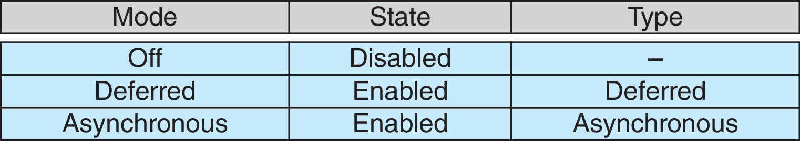
Thread Cancellation (Cont.)
Invoking thread cancellation requests cancellation, but actual cancellation depends on thread state
If thread has cancellation disabled, cancellation remains pending until thread enables it
Default type is deferred
  Cancellation only occurs when thread reaches cancellation point
    i.e., pthread_testcancel()
    Then cleanup handler is invoked
On Linux systems, thread cancellation is handled through signals

Slide 55
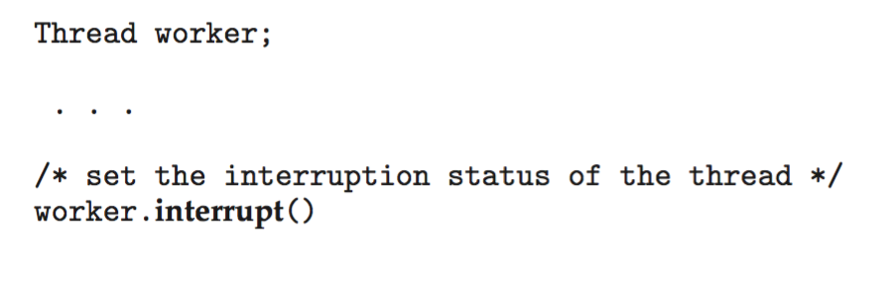
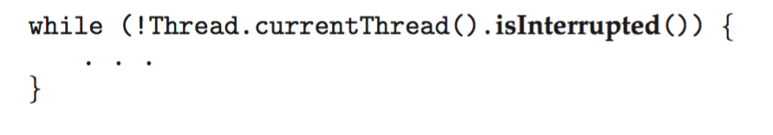
Thread Cancellation in Java
Deferred cancellation uses the interrupt() method, which sets the interrupted status of a thread.
A thread can then check to see if it has been interrupted:

Slide 56
Thread-Local Storage
Thread-local storage (TLS) allows each thread to have its own copy of data
Useful when you do not have control over the thread creation process (i.e., when using a thread pool)
Different from local variables
  Local variables visible only during single function invocation
  TLS visible across function invocations
Similar to static data
  TLS is unique to each thread

Slide 57
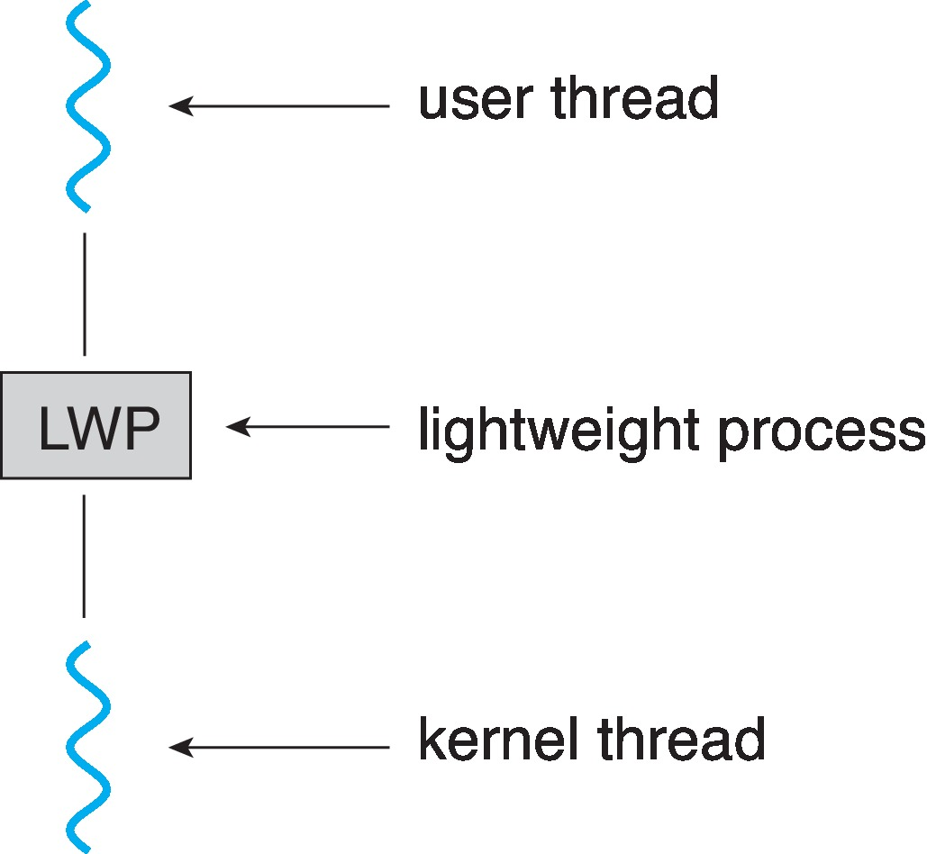
Scheduler Activations
Both M:M and Two-level models require communication to maintain the appropriate number of kernel threads allocated to the application
Typically use an intermediate data structure between user and kernel threads – lightweight process (LWP)
  Appears to be a virtual processor on which process can schedule user thread to run
  Each LWP attached to kernel thread
  How many LWPs to create?
Scheduler activations provide upcalls - a communication mechanism from the kernel to the upcall handler in the thread library
This communication allows an application to maintain the correct number kernel threads

Slide 58
Operating System Examples
Windows Threads
Linux Threads
Notes:
58

Slide 59
Windows Threads
Windows API – primary API for Windows applications
Implements the one-to-one mapping, kernel-level
Each thread contains
  A thread id
  Register set representing state of processor
  Separate user and kernel stacks for when thread runs in user mode or kernel mode
  Private data storage area used by run-time libraries and dynamic link libraries (DLLs)
The register set, stacks, and private storage area are known as the context of the thread

Slide 60
Windows Threads (Cont.)
The primary data structures of a thread include:
  ETHREAD (executive thread block) – includes pointer to process to which thread belongs and to KTHREAD, in kernel space
  KTHREAD (kernel thread block) – scheduling and synchronization info, kernel-mode stack, pointer to TEB, in kernel space
  TEB (thread environment block) – thread id, user-mode stack, thread-local storage, in user space

Slide 61
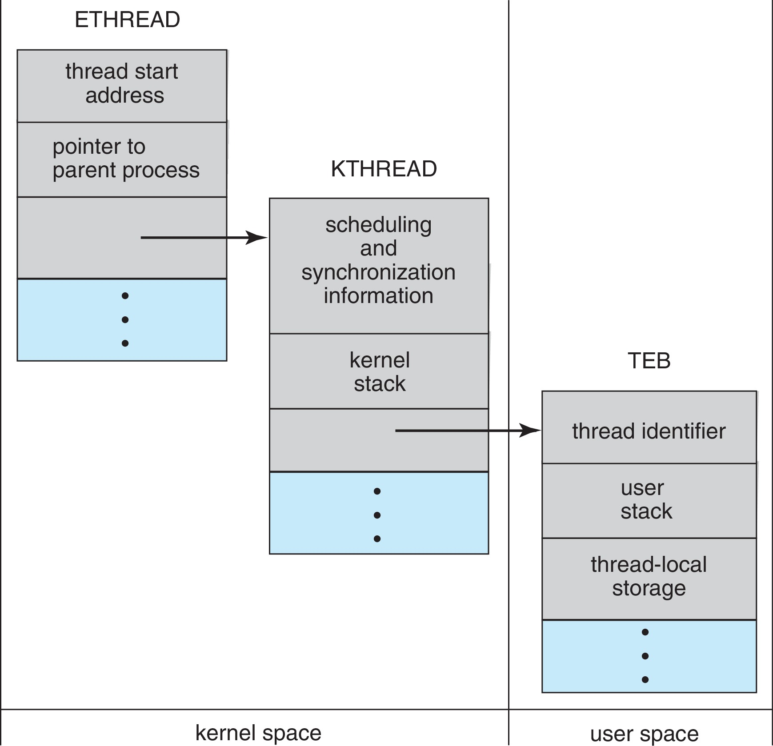
Windows Threads Data Structures

Slide 62
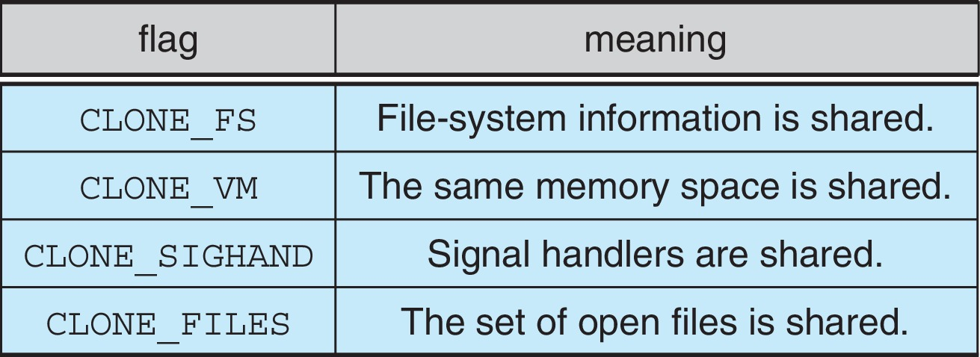
Linux Threads
Linux refers to them as tasks rather than threads
Thread creation is done through clone() system call
clone() allows a child task to share the address space of the parent task (process)
  Flags control behavior
struct task_struct points to process data structures (shared or unique)

Slide 63
End of Chapter 4

